Slide 1
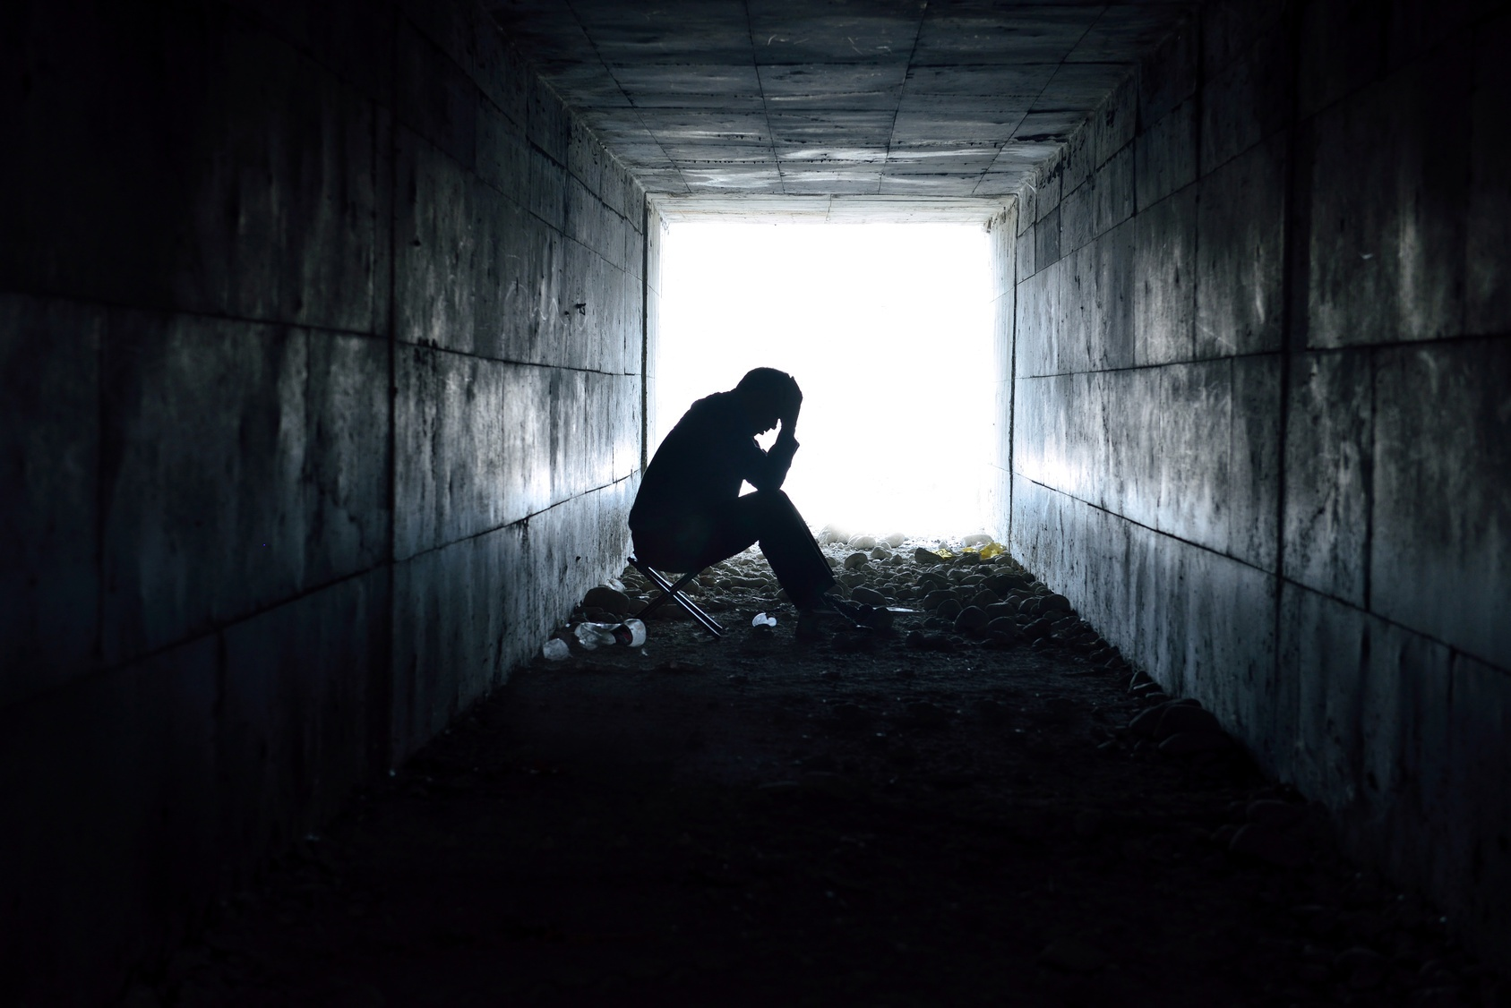
BBM421 GAME TECHNOLOGIES PROJECT
AGATEOPHOBIA
Ali Sahin Balikci
Gokay Atay
Sena Berre Ceylan

Slide 2
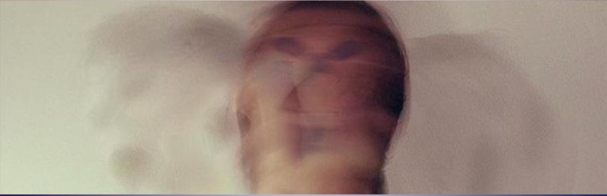
DESCRIPTION of the Game / RemInder
Agateophobia is a single player horror game. It can be defined under tags as horror, adventure, puzzle, mystery, choices/actions matters and story rich. It consists of three levels that individually designed and each level has different puzzle/puzzles. These puzzles will affect the ending of the game. Also player's choices and actions may change the game progress and gameplay.

Slide 3
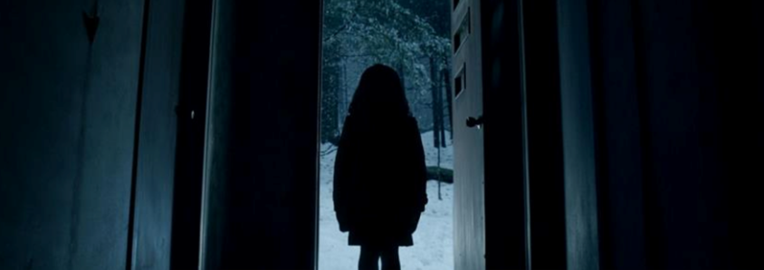
Agateophobia's main story consists of a paranoid man, his past, present thoughts and dreams. Like his daughter's death, bad things he's been through combined with his phobia makes him insane. He starts to see the reality different, depending on his subconscious. He blames himself about his daughter’s death (burnt in their house), and through the game he is hallucinating about his daughter, places that he’s been through and so on.

Slide 4
Agateophobia can be played in first person view, player experiences the action through the eyes of the protagonist and can control the character via keyboard/mouse. Environment changes in each level and player can interact with some objects in the scenes. There will be some cinematics occurred in the gameplay and there are some horror stuff like sound effects and jump-scares.

Slide 5
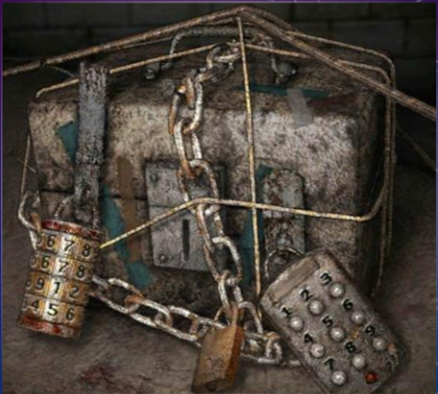
Player is forced to discover the environment in an undirected way. Puzzles must be solved for the game progress, also these puzzles and timing is important for the ending.

Slide 6
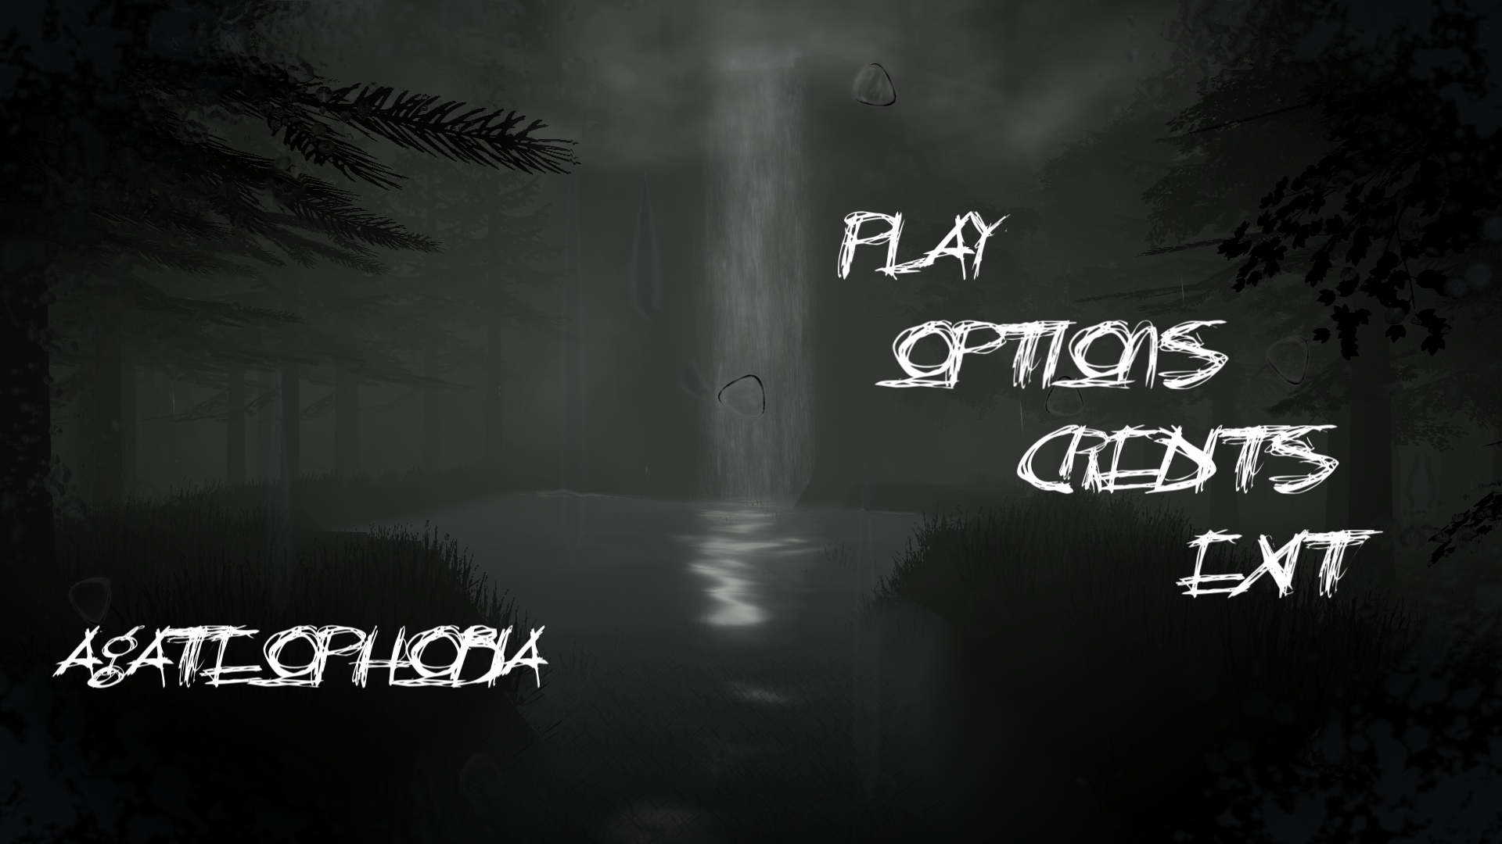
MAIN MENU

Slide 7
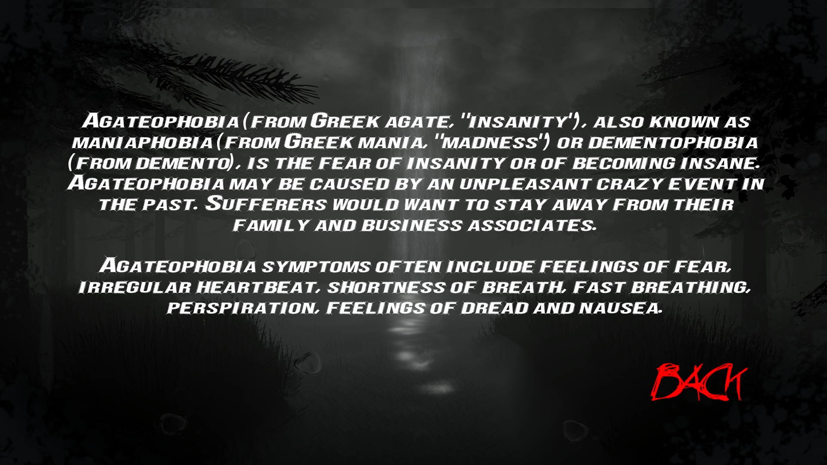
AGATEOPHOBIA (SUB-MENU)

Slide 8
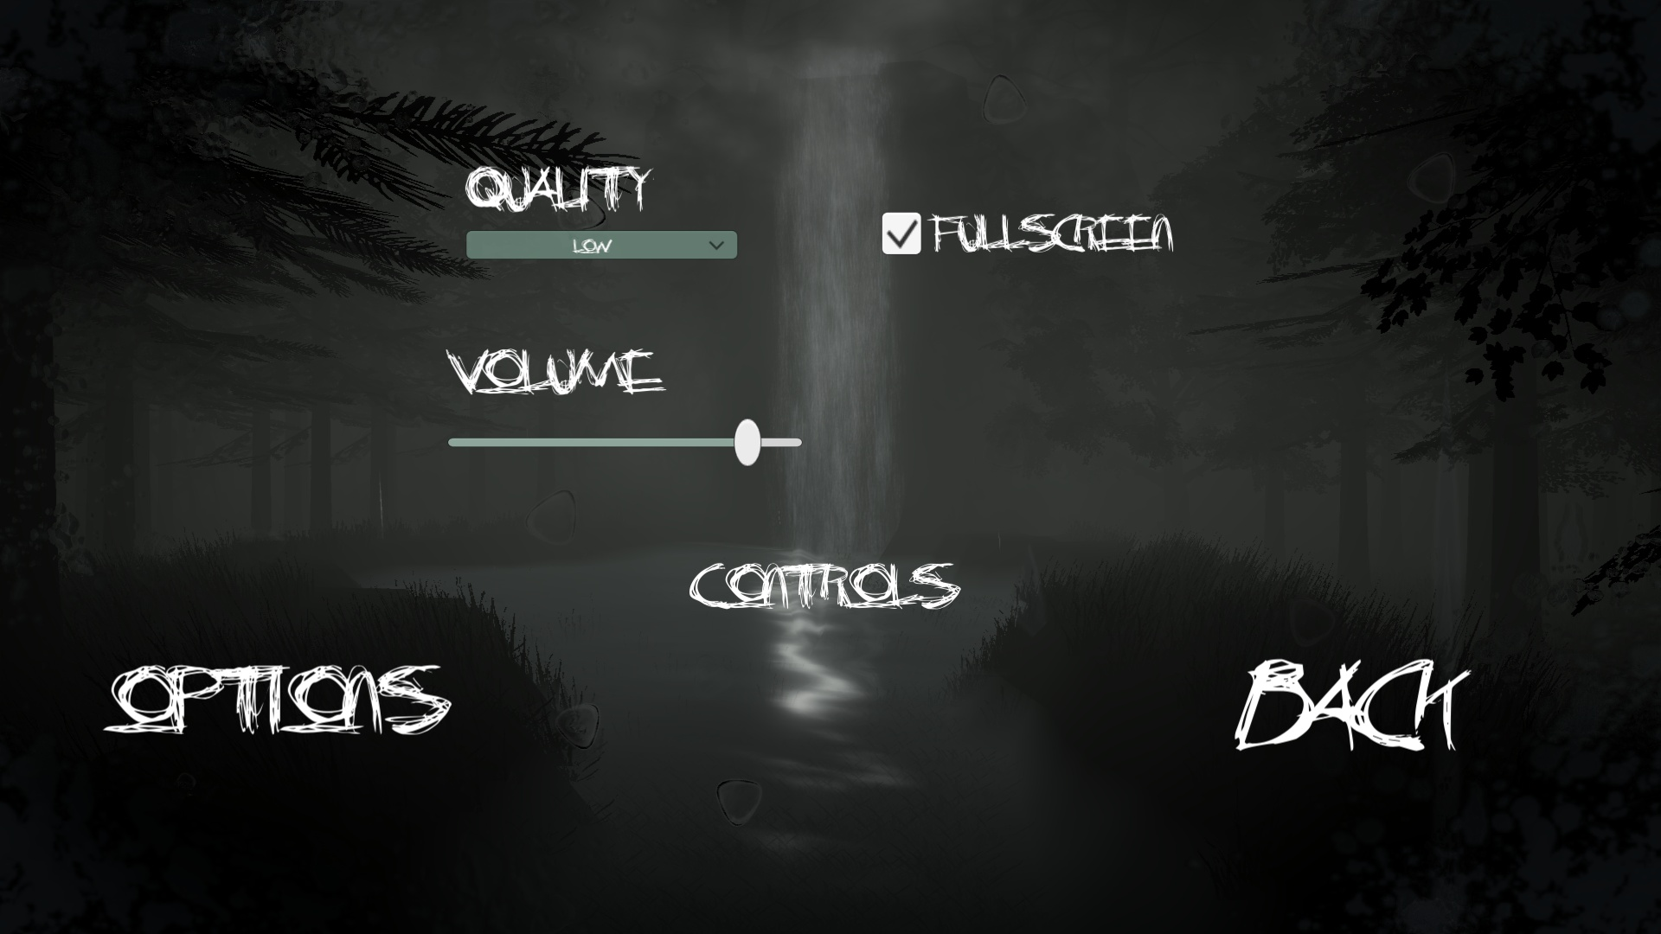
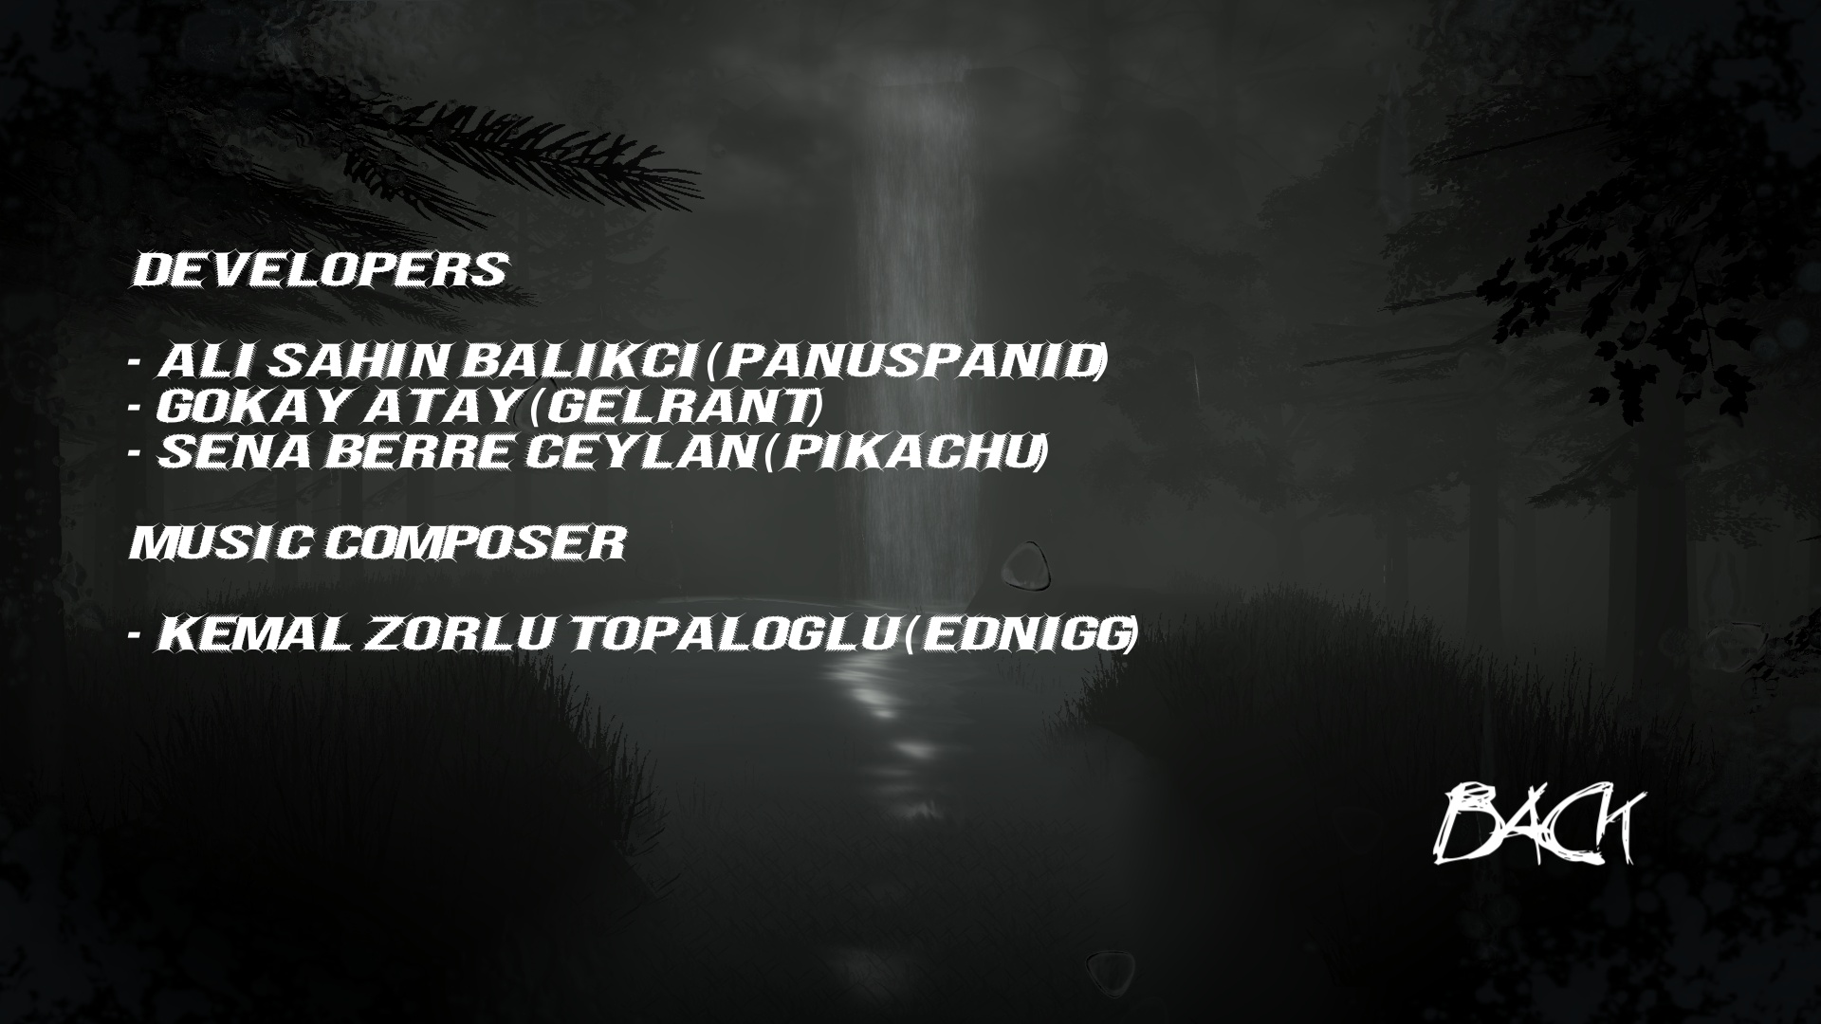
OPTIONS & CREDITS (SUB-MENU)
OPTIONS
CREDITS

Slide 9
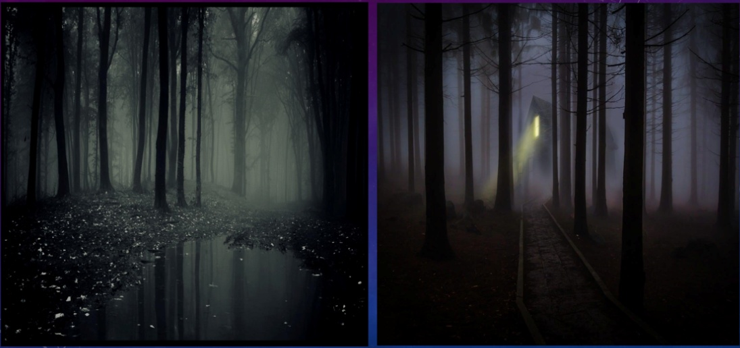
LEVEL 1 – HAUNTED FOREST (SUMMARY OF #P1)
We mentioned before, on the project proposal, how the haunted forest scene would look like.

Slide 10
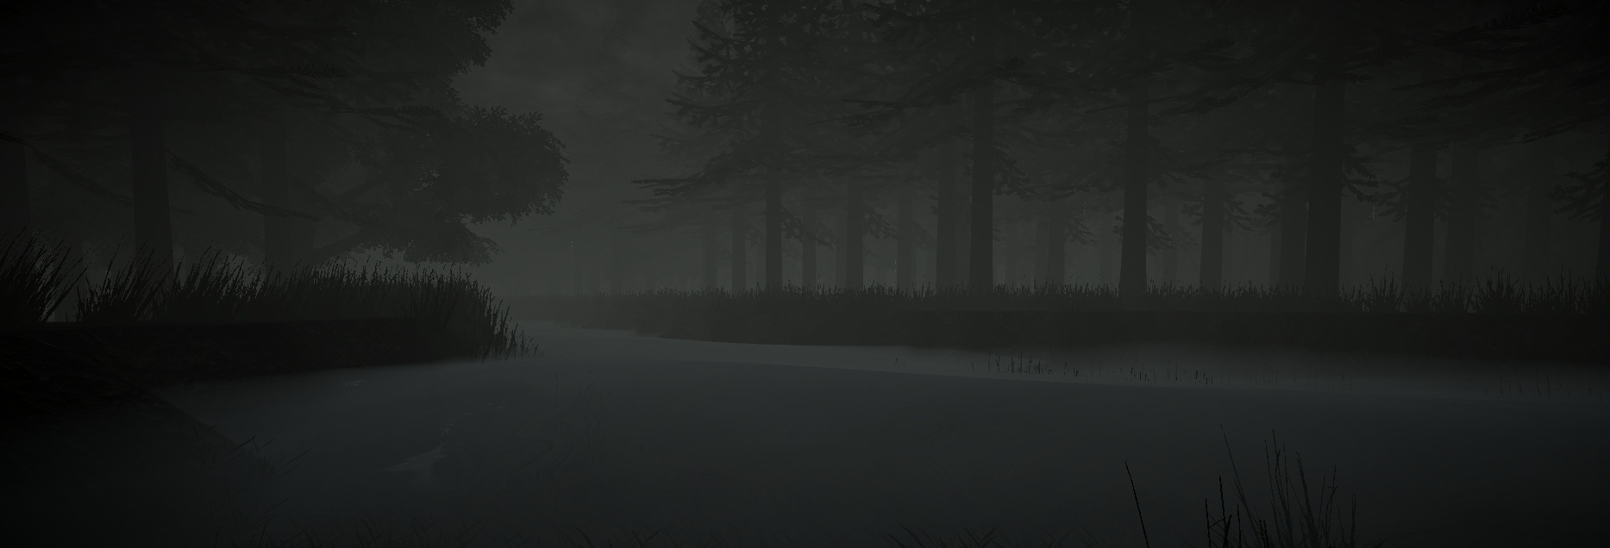
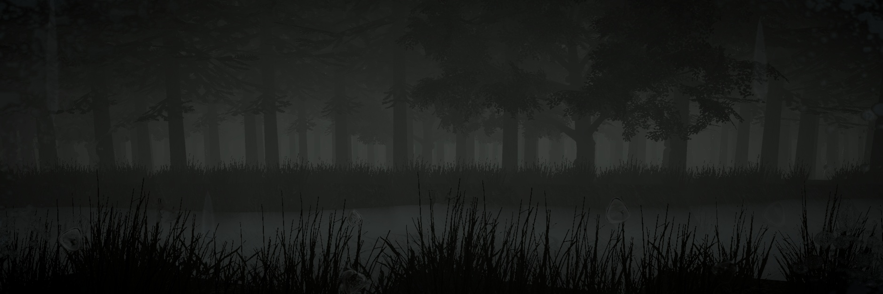
General View of the Forest

Slide 11
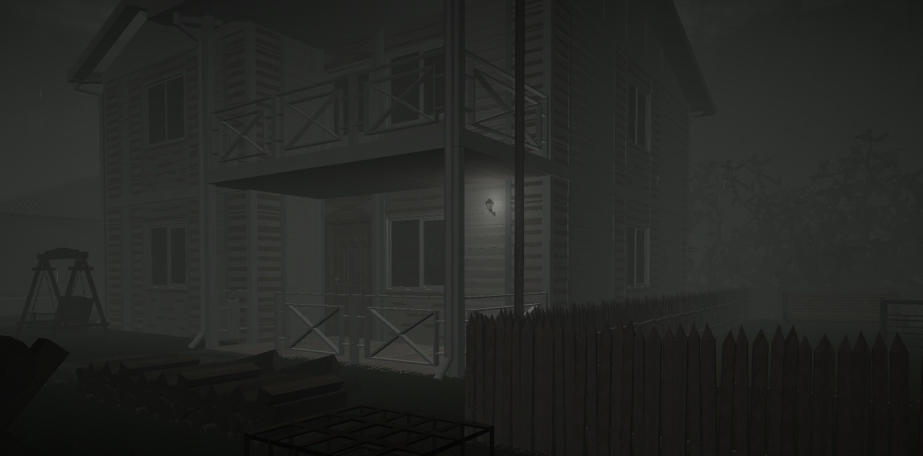
View of the Main Character's House

Slide 12
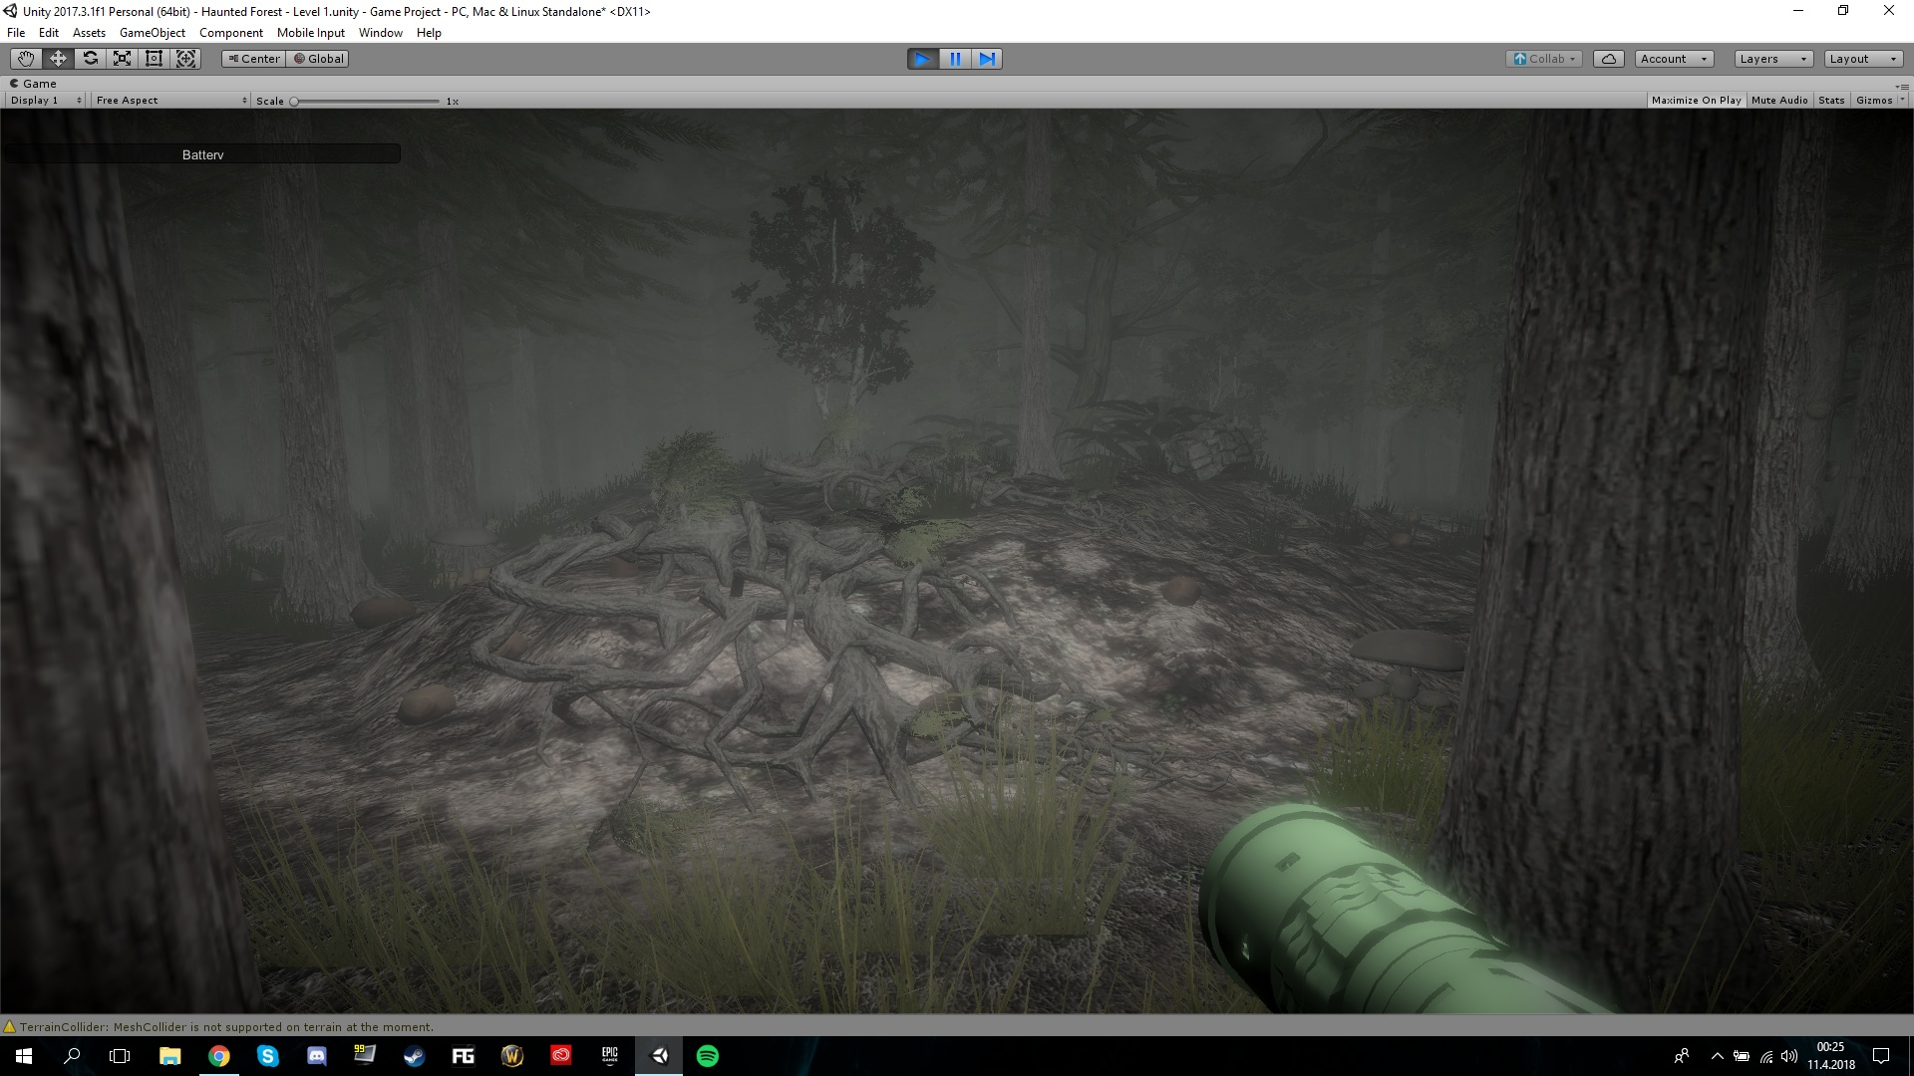
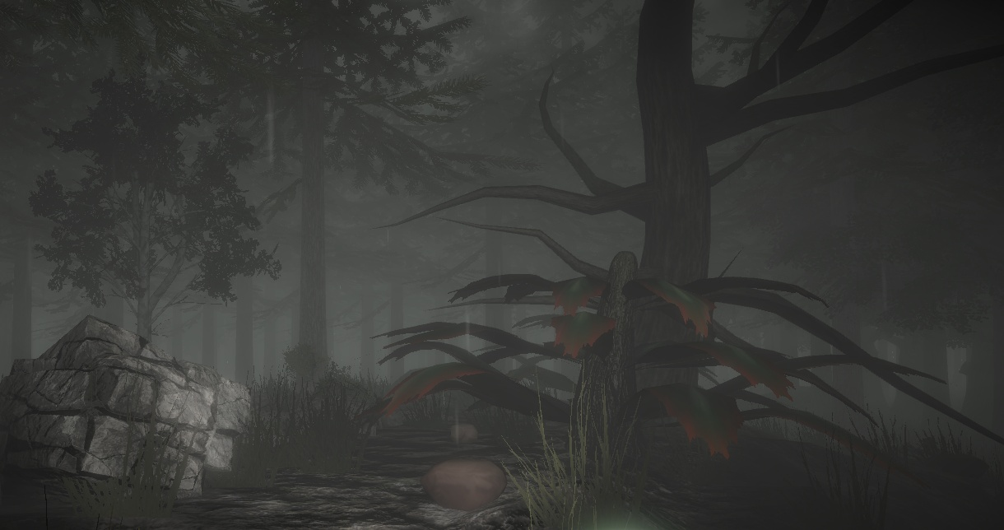
Different assets such as roots, trees/plants, stones/boulders and mushrooms are placed on the scene. We've created a foggy environment to reflect a scary forest.

Slide 13
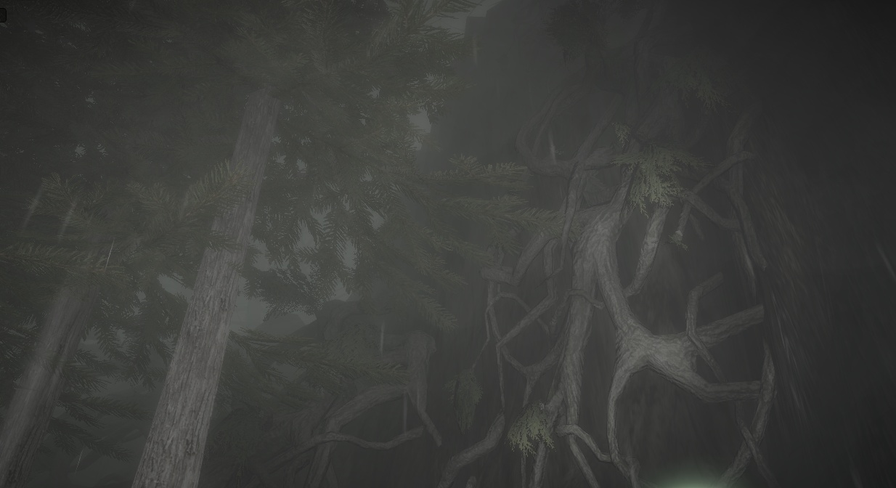
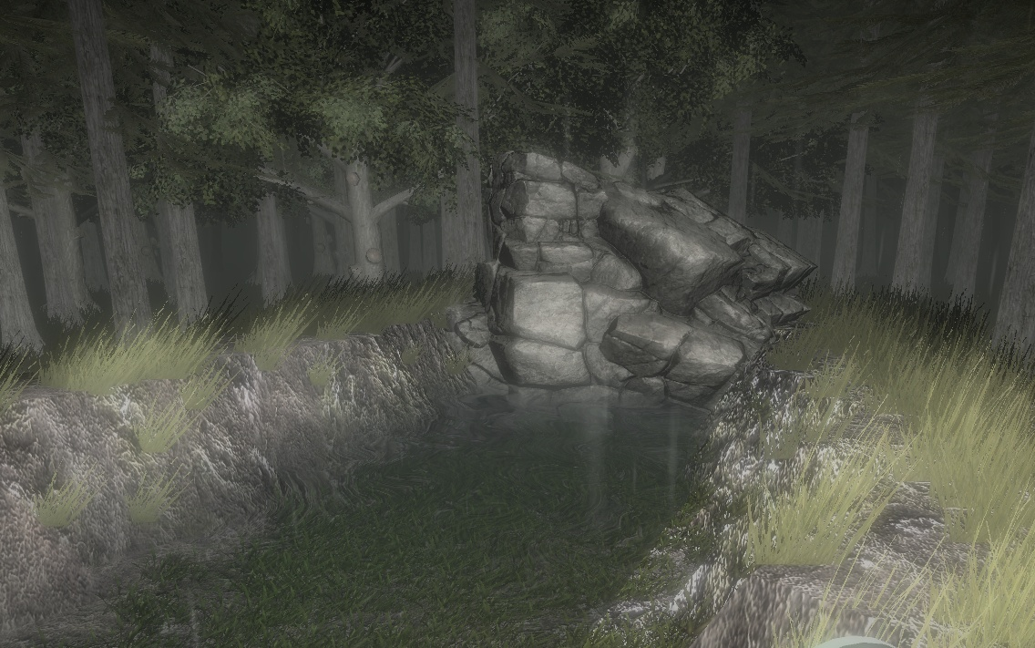

Slide 14
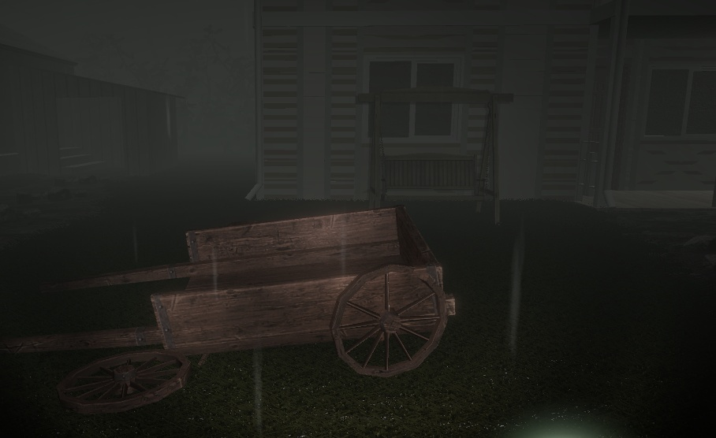
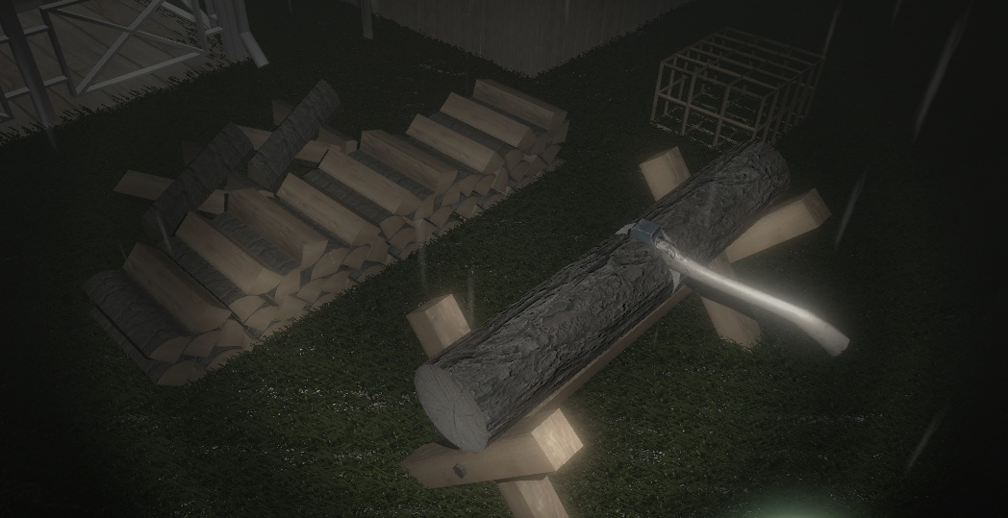
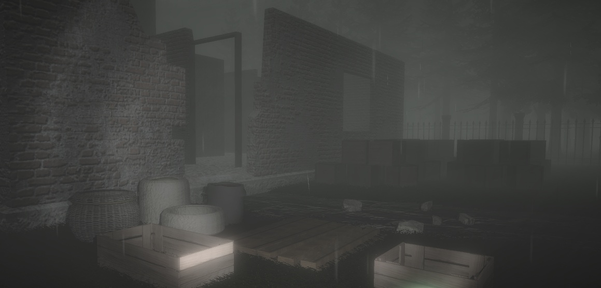
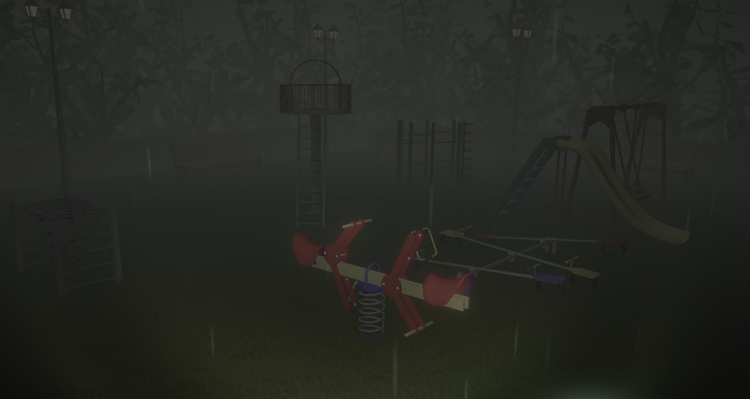

Slide 15
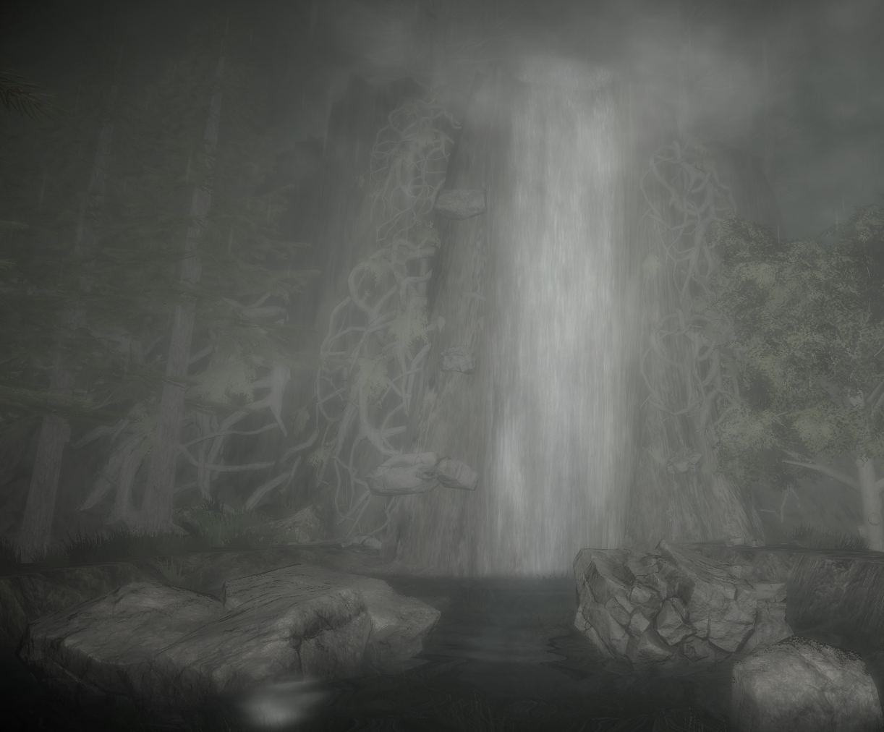
LEVEL 1 – HAUNTED FOREST (#P2) SOME DETAILS

Slide 16
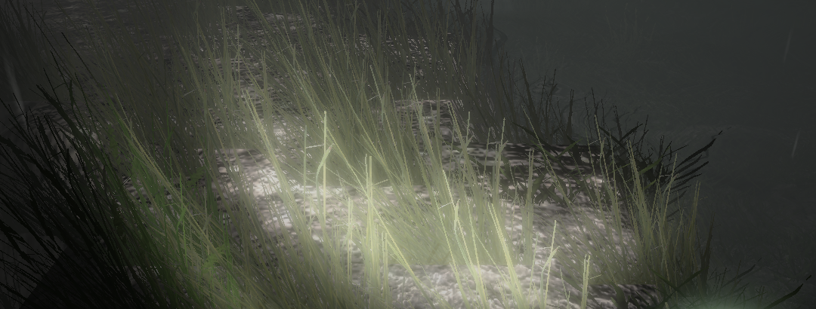
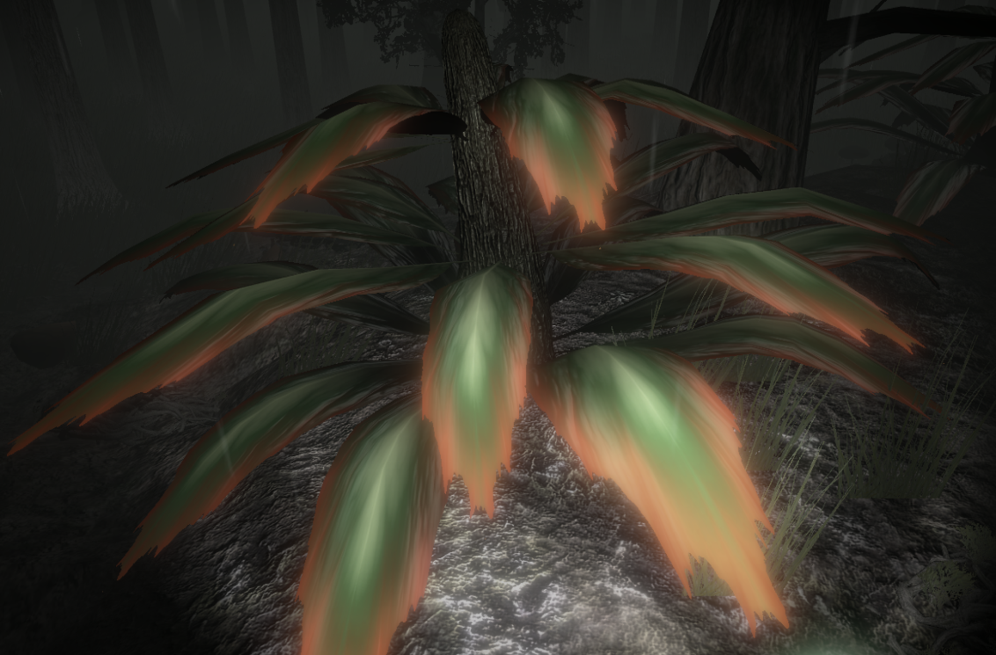
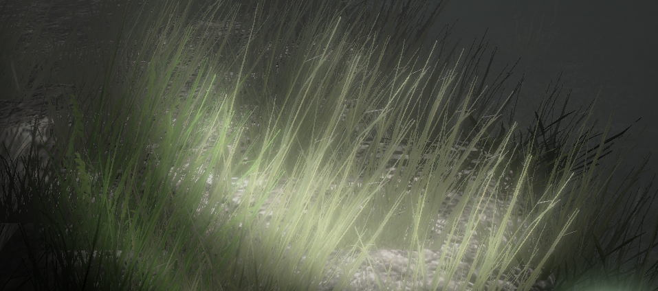
WINDZONE
Wind effect on tree leaves/grass is created using Unity’s windzone, this made it easier for the user to feel that the atmosphere is bad and creepy.

Slide 17
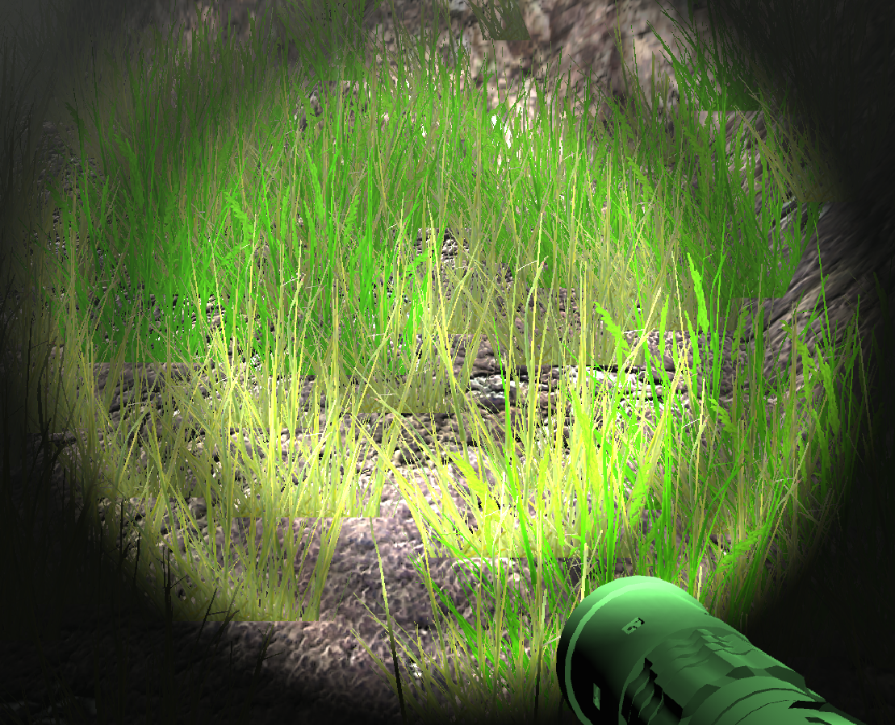
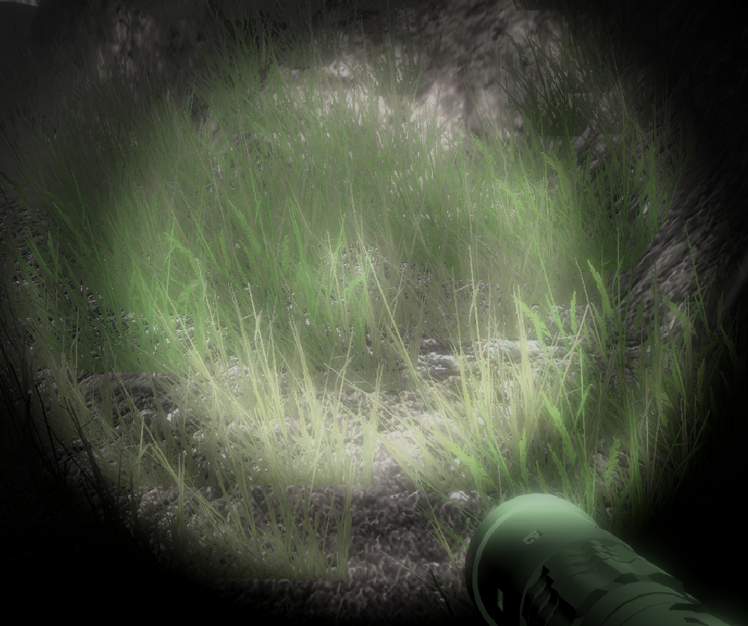
POST PROCESSING
Post-processing (Unity Asset) is the process of applying full-screen filters and effects to a camera’s image buffer before it is displayed to screen.

Slide 18
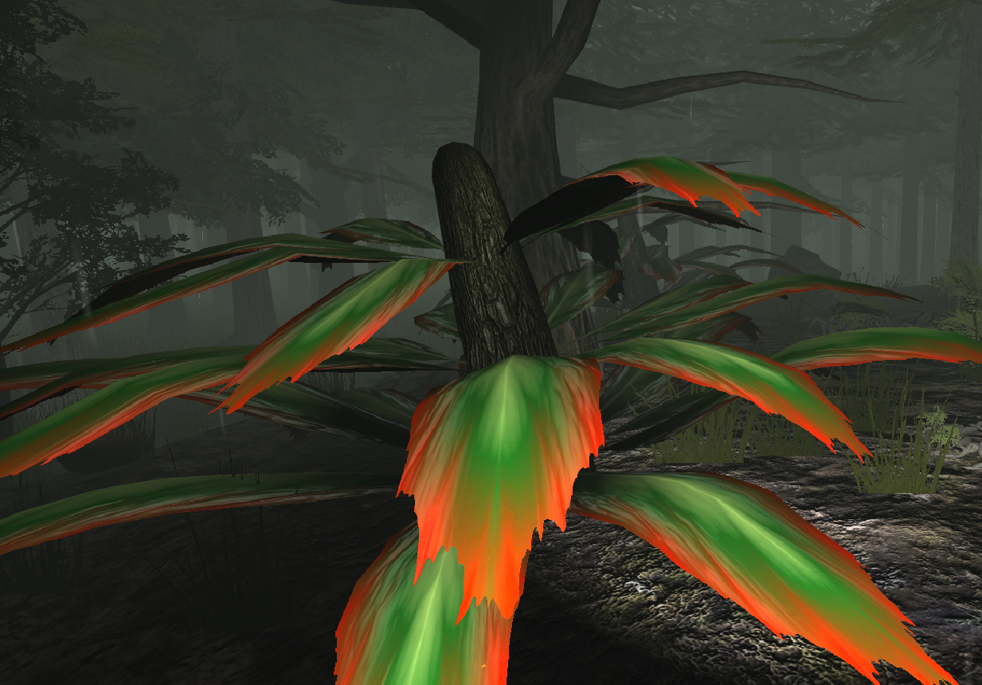
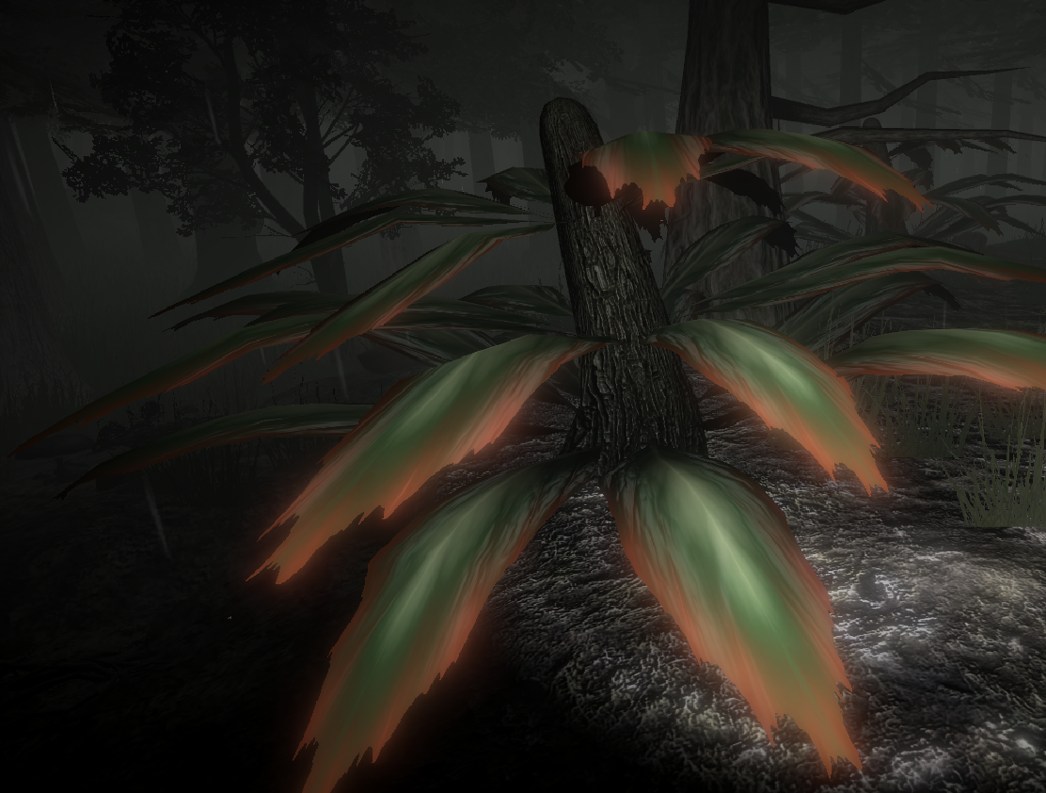
Fog, bloom, vignette, depth of field and color grading attributes are used to make scene look more frightening.

Slide 19
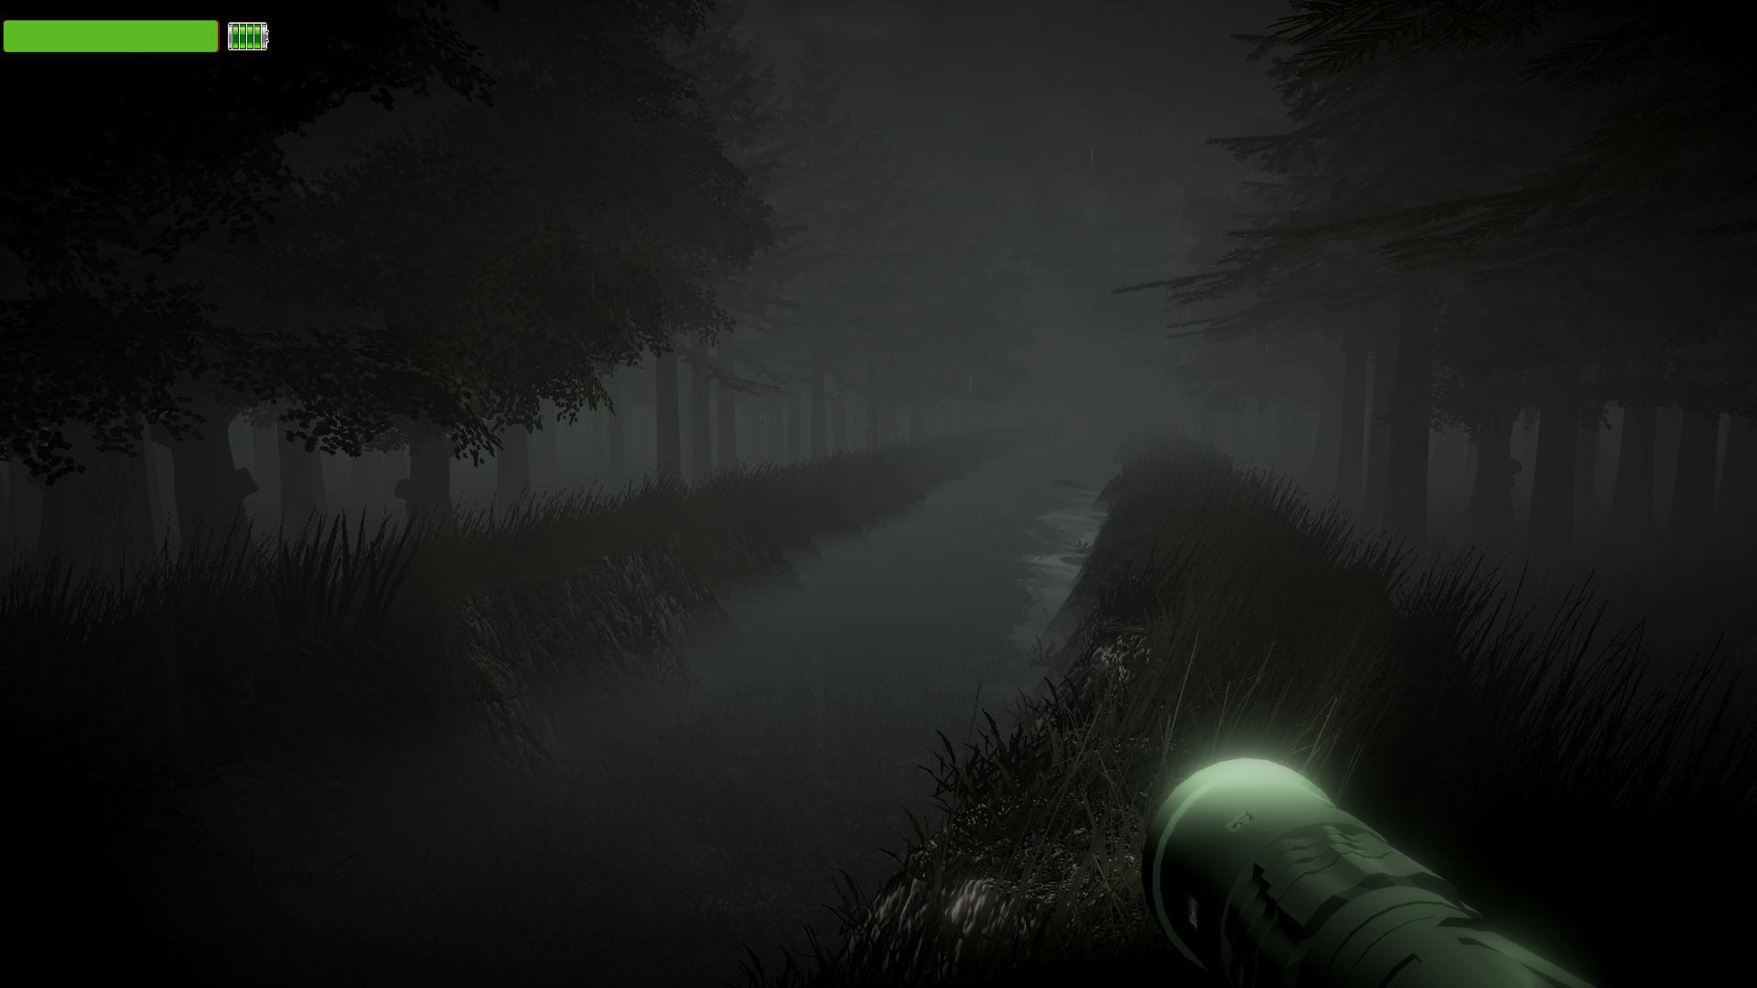
FLASHLIGHT & UI

Slide 20
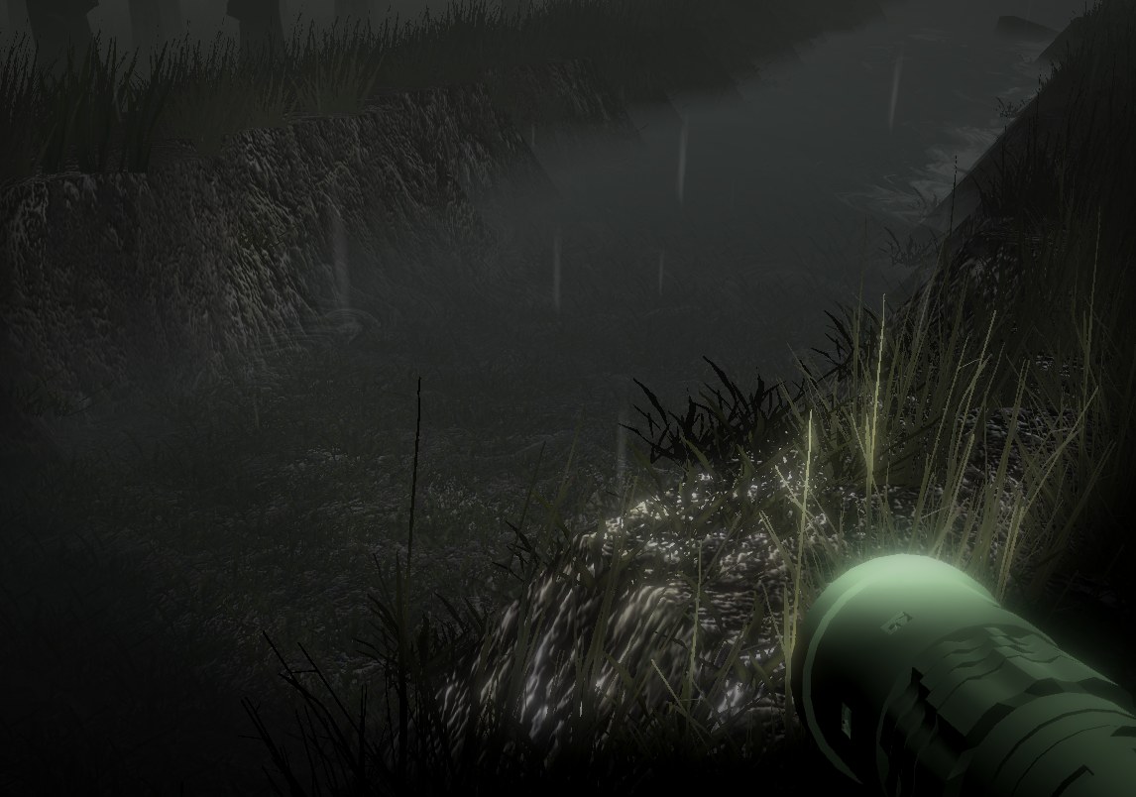
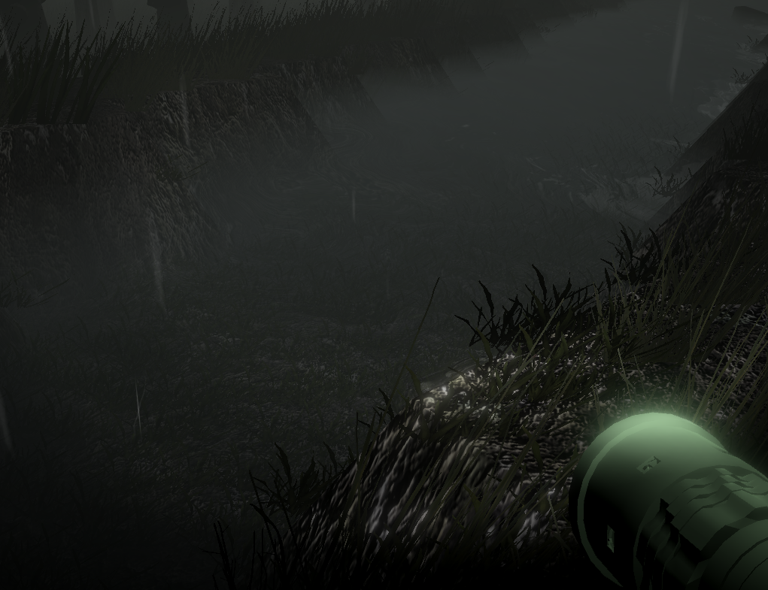
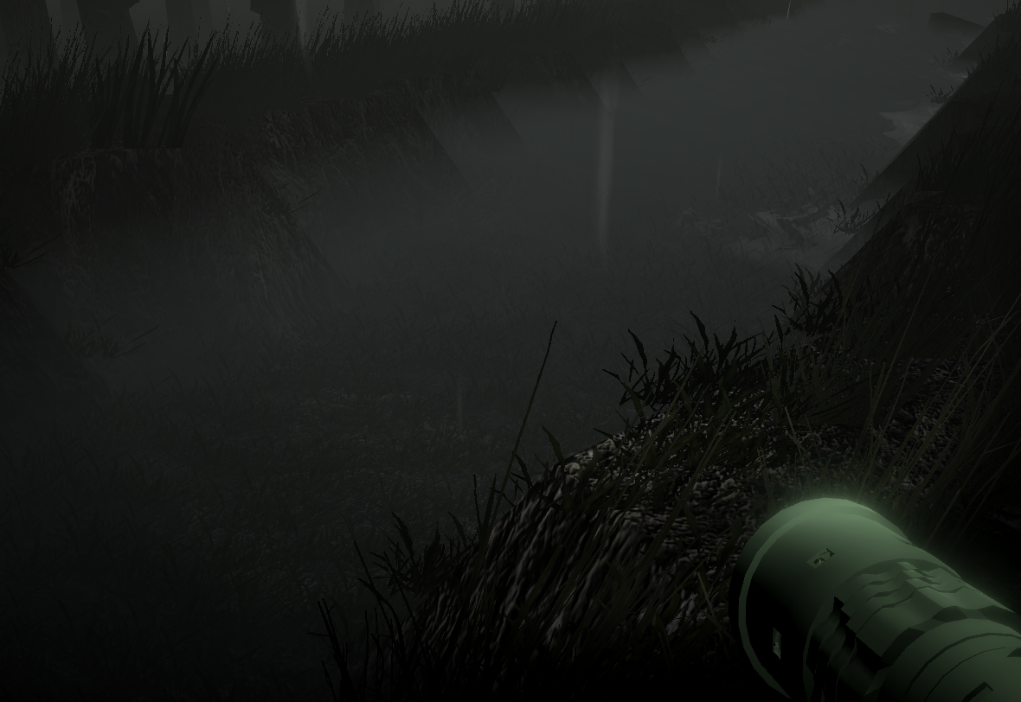



The battery is diminished as long as the flashlight is kept open, the intensity of the light will decrease and at the end it will close. Also player can follow the battery power on the upper left screen GUI.

Slide 21
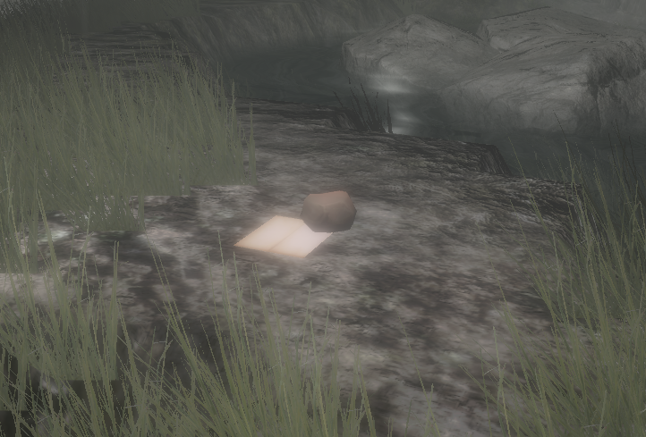
PUZZLE WALKTHROUGH
By leaving notes for the character, we aimed to design a puzzle that requires user to think about the content of the note. Also notes uses little pieces of the story.

Slide 22
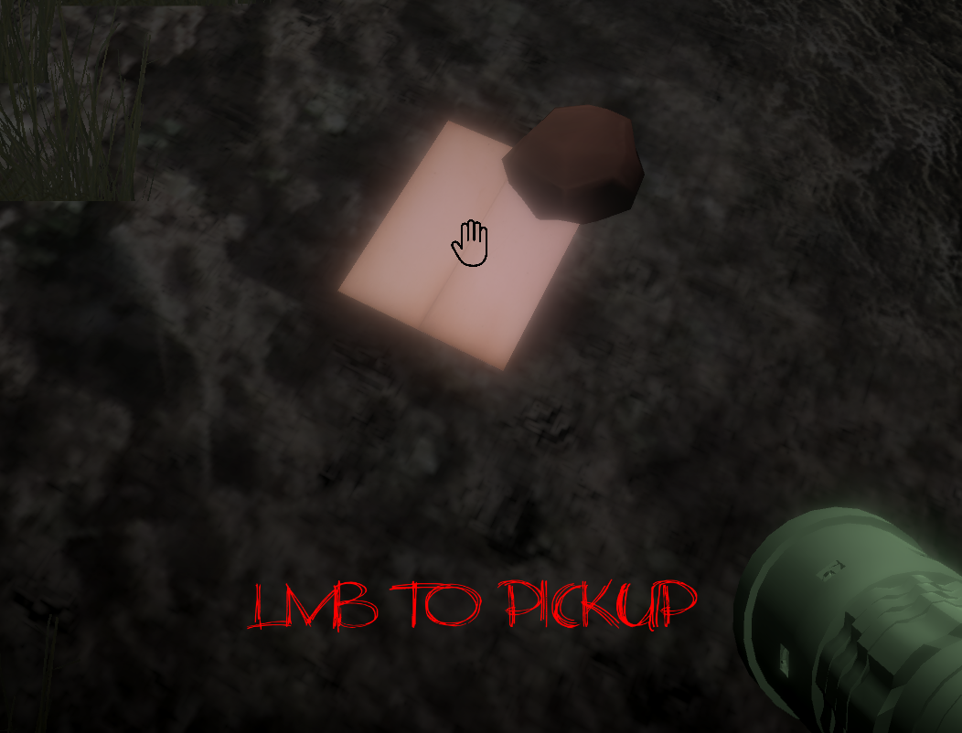
- When user gets close to the note and looks at the note, a hand icon and a message appears on the screen.
- There are 3 notes in the scene and each note appears in specific order. If user does not take the first note, the second one will not appear until user gets the first one.
- When user takes the note, FPSController will be deactivated, so user cannot walk before leaving the note.

Slide 23
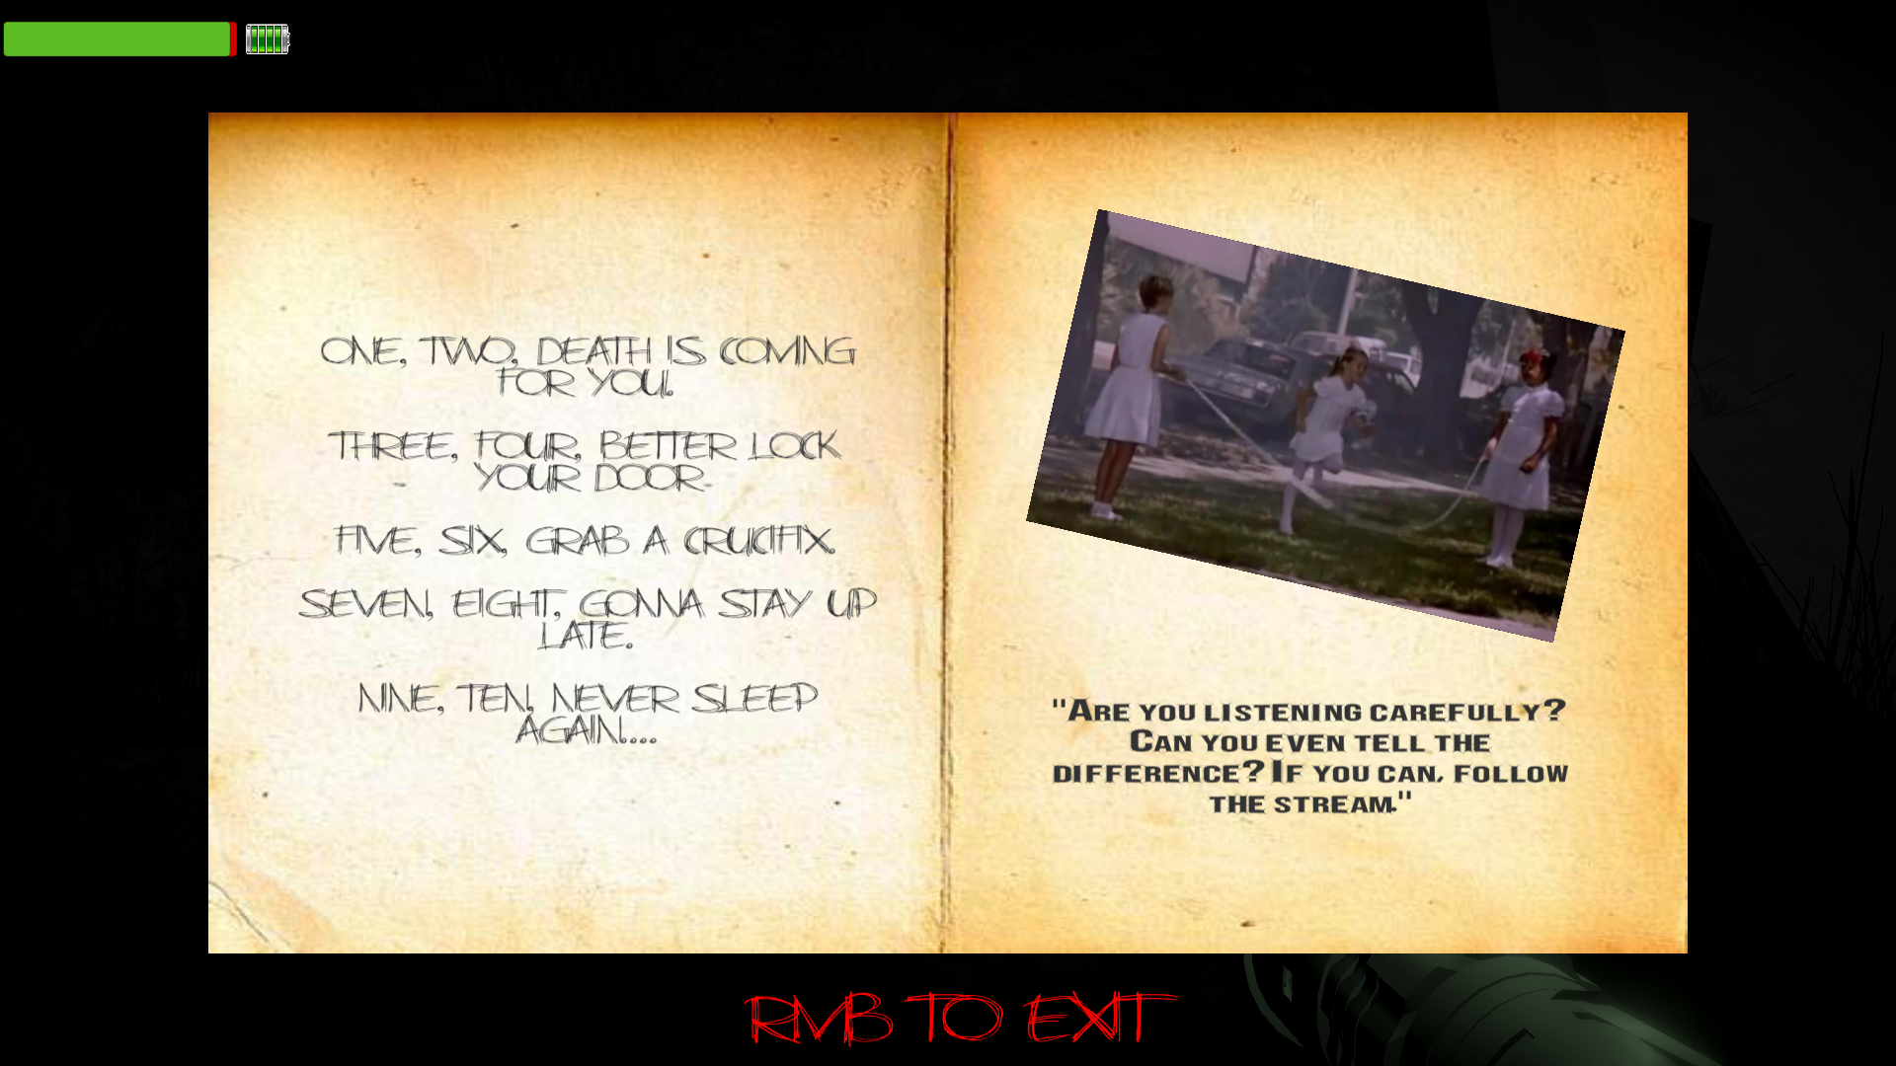
FIRST NOTE
Bold written text is a hint for the player.
- In the first note there will be nursery rhyme played on the background (Written on the left side).
Girl on the photo is his daughter actually. But we will get into that storytelling in the last demo.
One word differs from the song, we want user to notice that word. (“Death”)

Slide 24
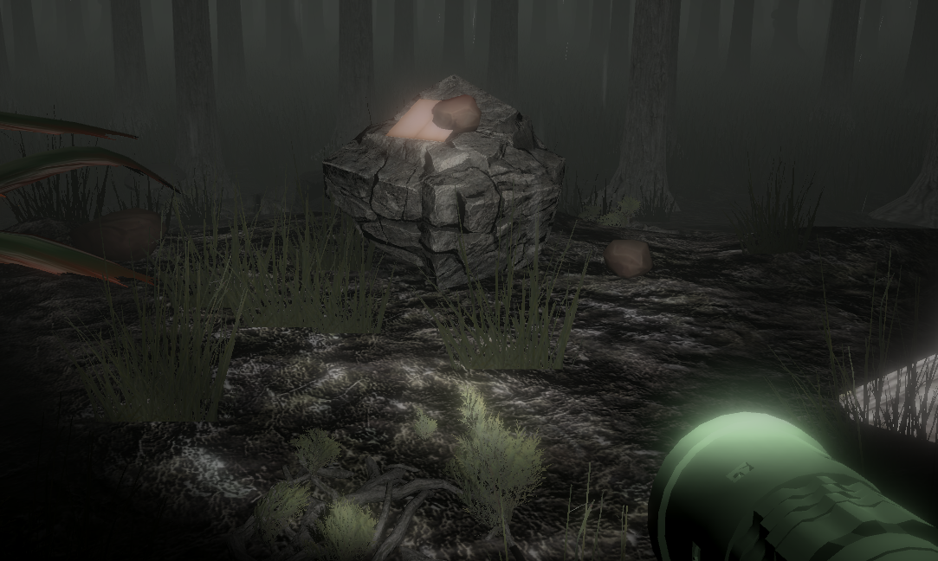
SECOND NOTE

Slide 25
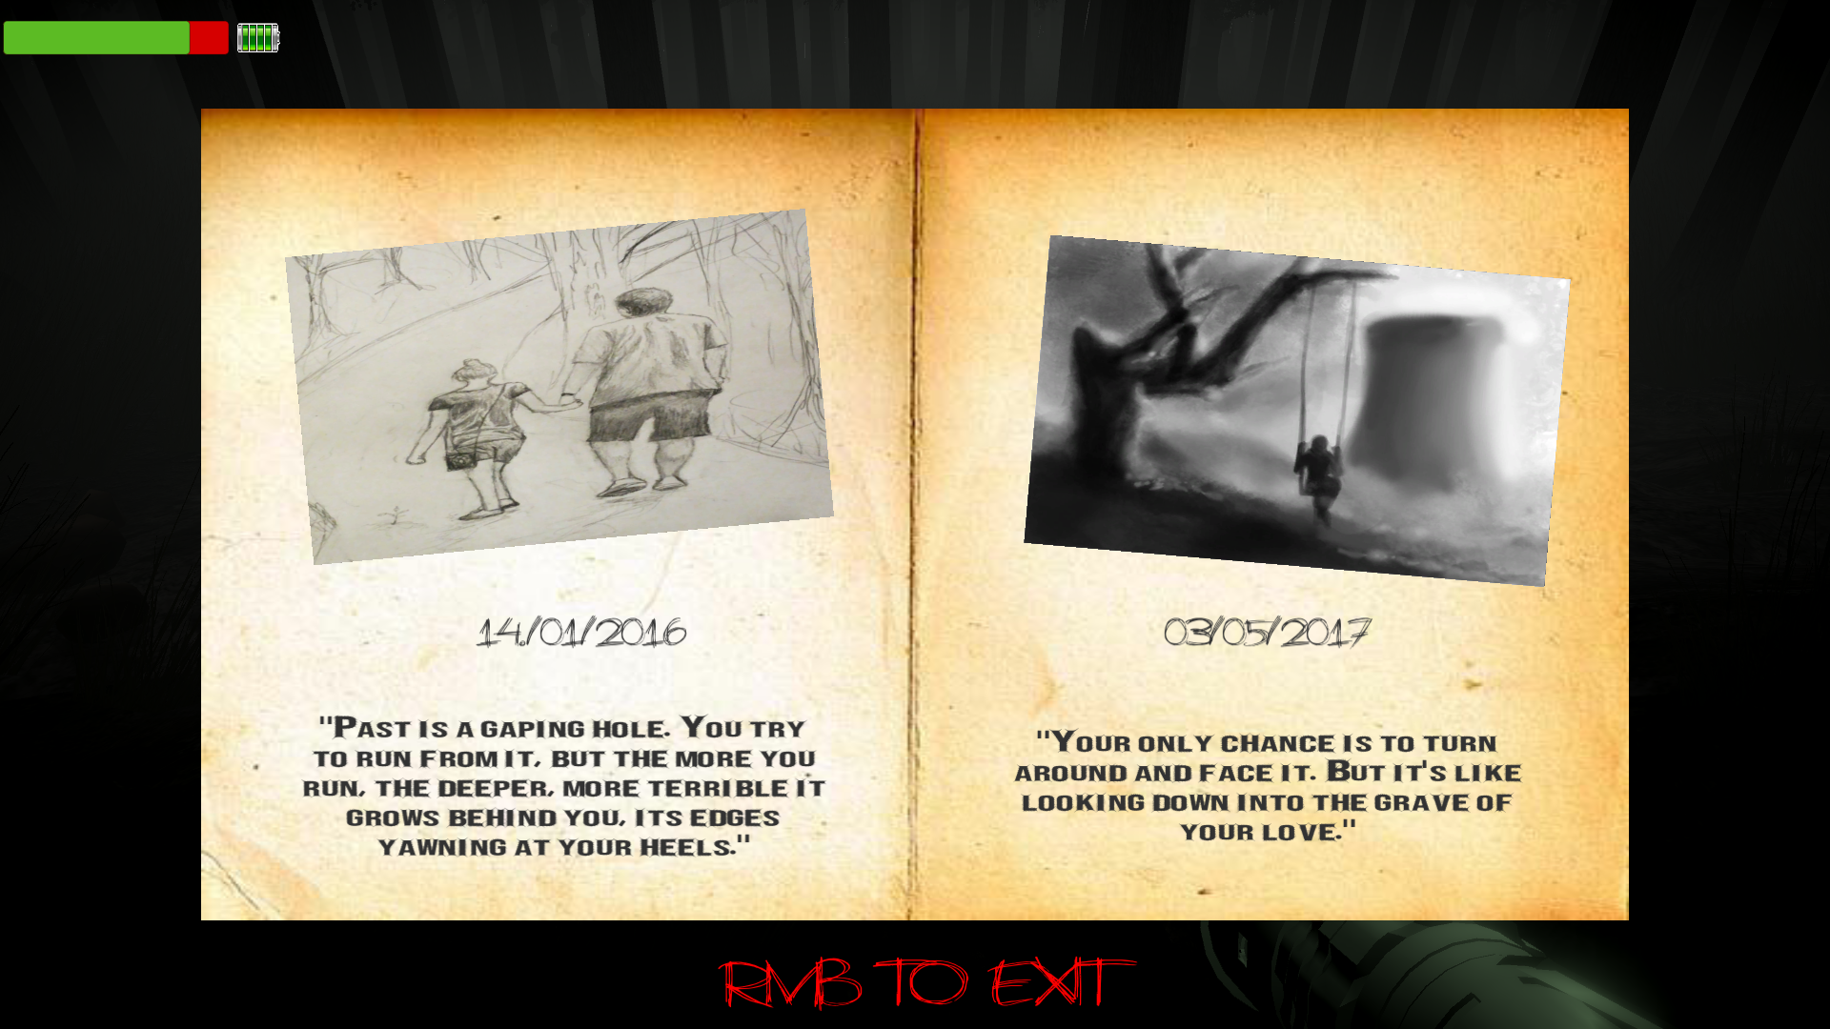
Bold written text is a hint for the player.
- In the second note there will be background sound of girl singing “La La La”.
Photos are the drawing of the father (main character) and daughter.
We want user to remember the date, when girls swings alone. (“03/05/17”)

Slide 26
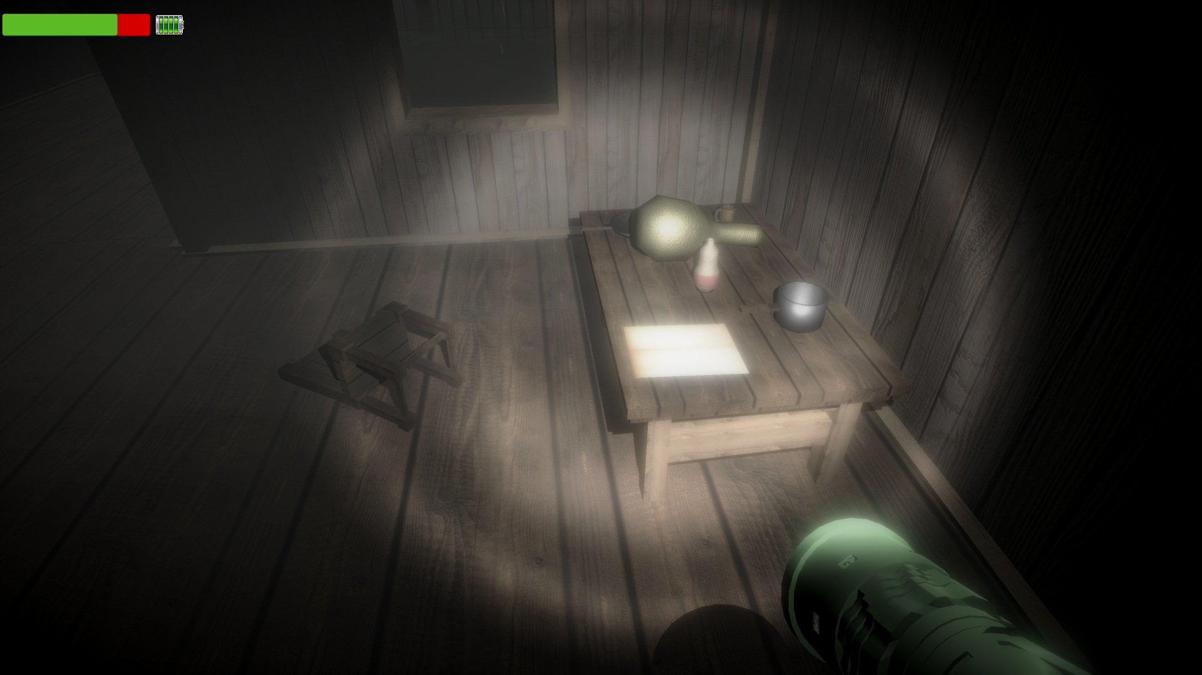
THIRD NOTE

Slide 27
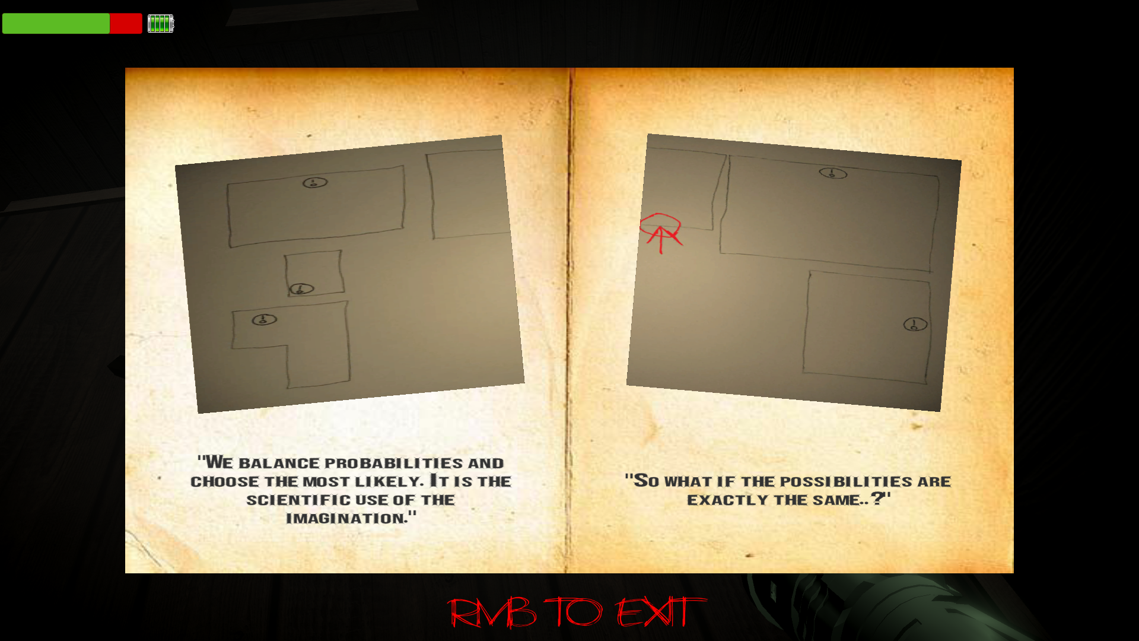
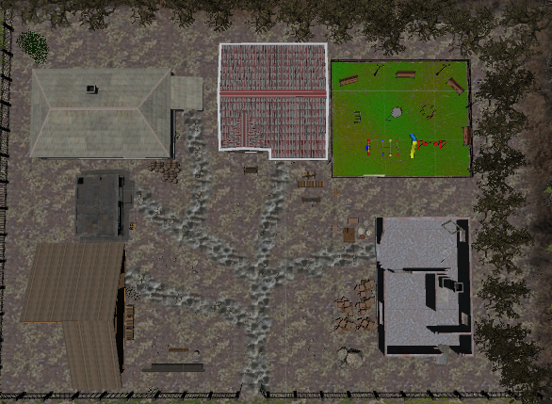
Bold written text is a hint for the player.
Photos are the drawing of the house and its surroundings.
We want user to find a key looking at this map, there are 5 different key locations. Key spawns at one of these locations randomly.

Slide 28
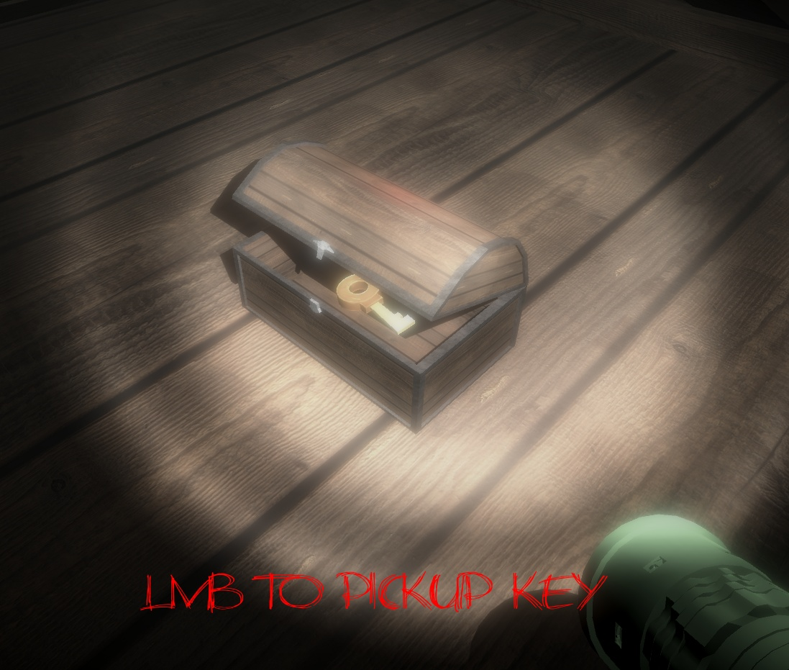
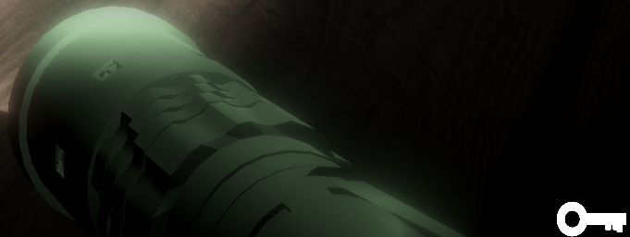
FINDING THE KEY

Slide 29
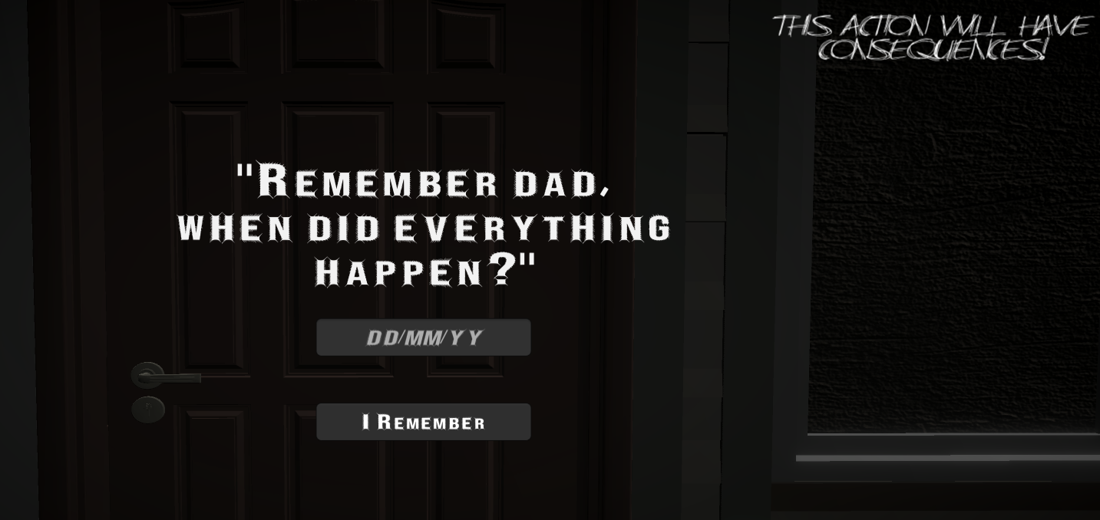
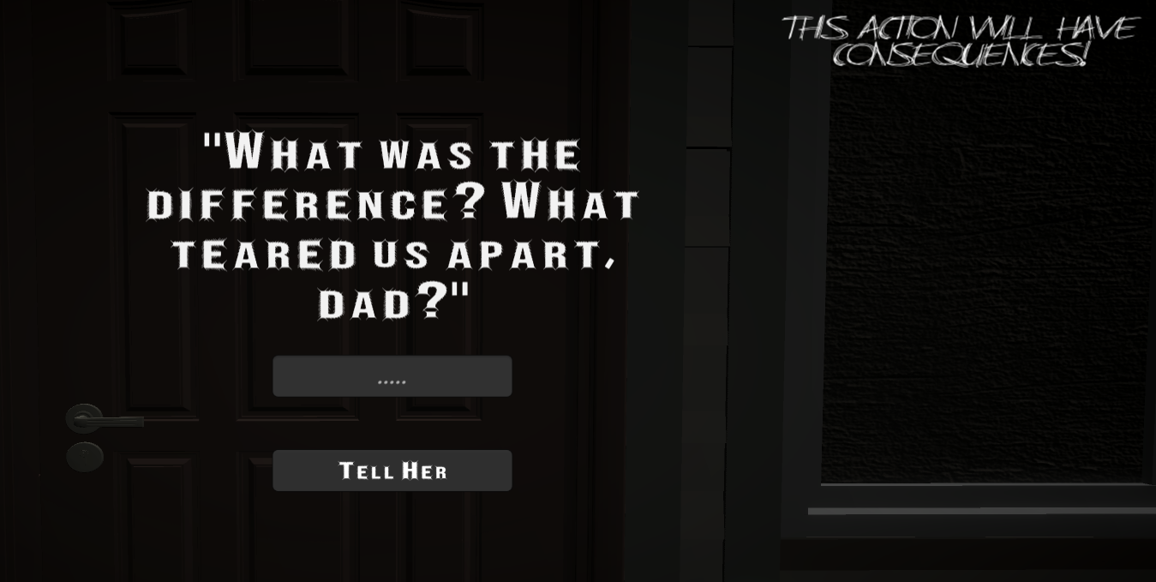
FINISHING THE PUZZLE
"03/05/17"
"Death"

Slide 30
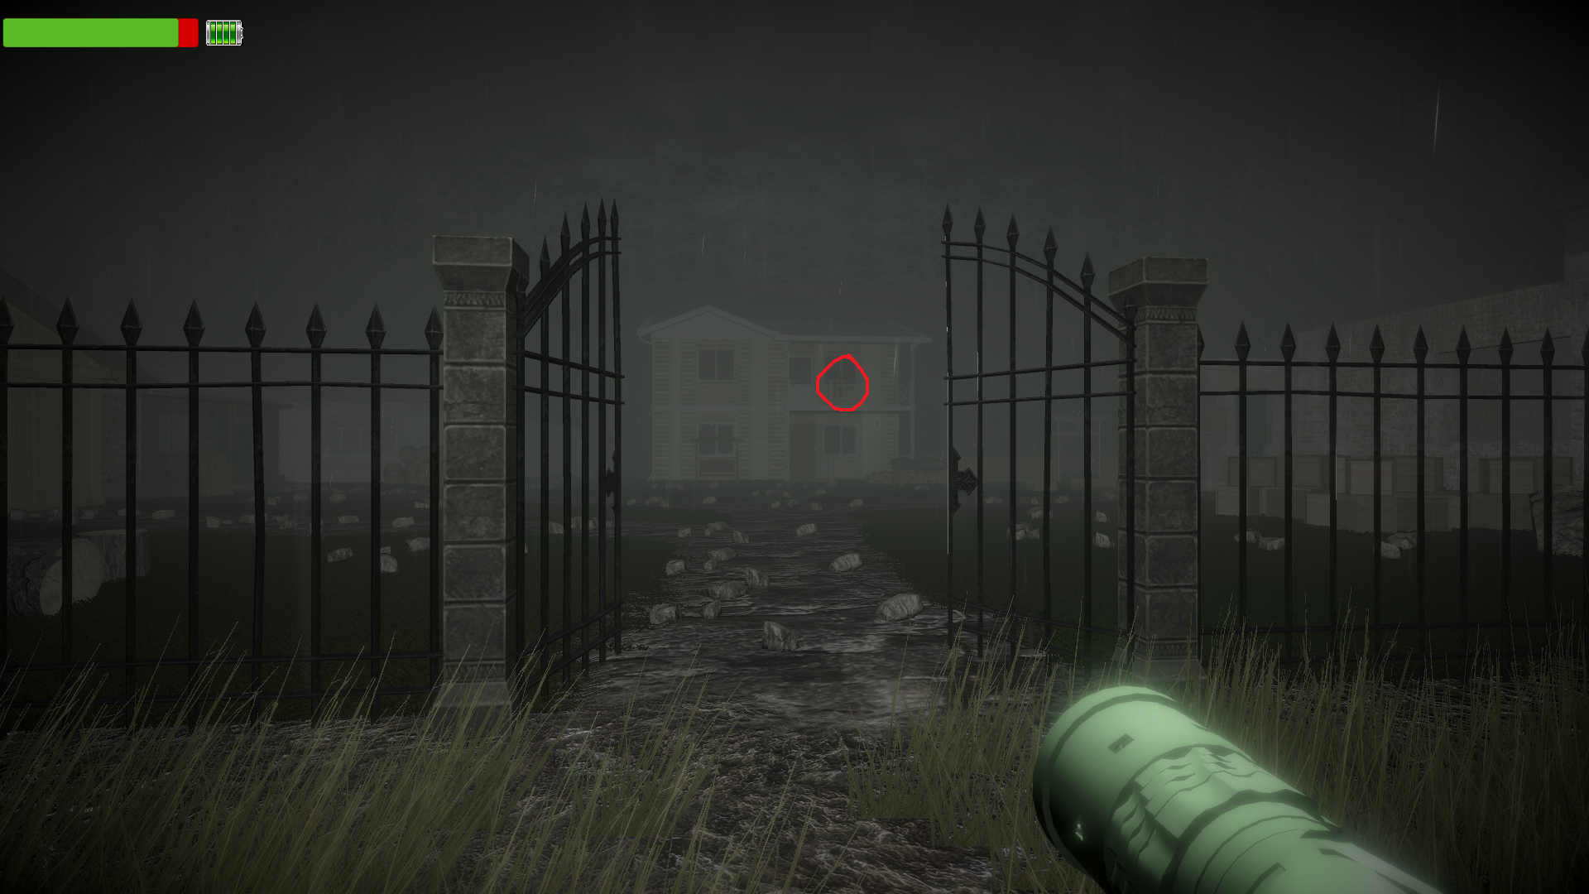
CREEPY MOMENTS

Slide 31
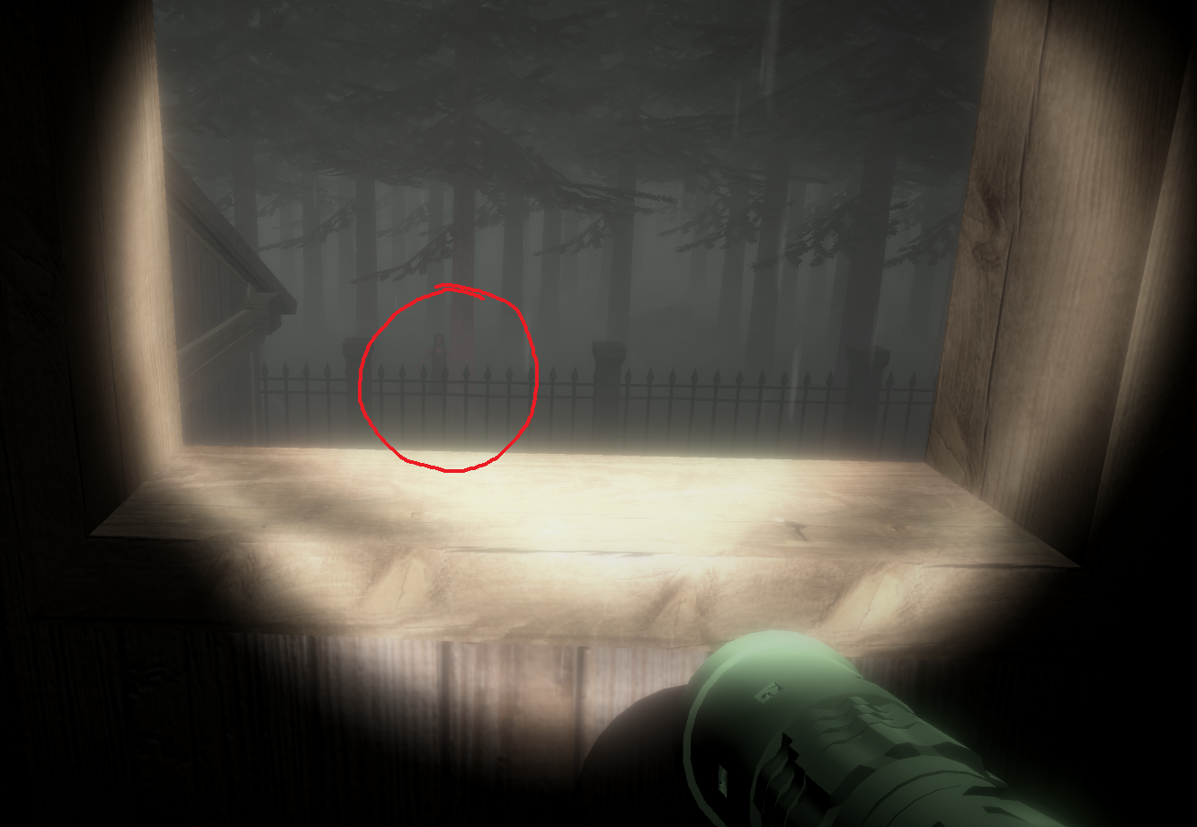
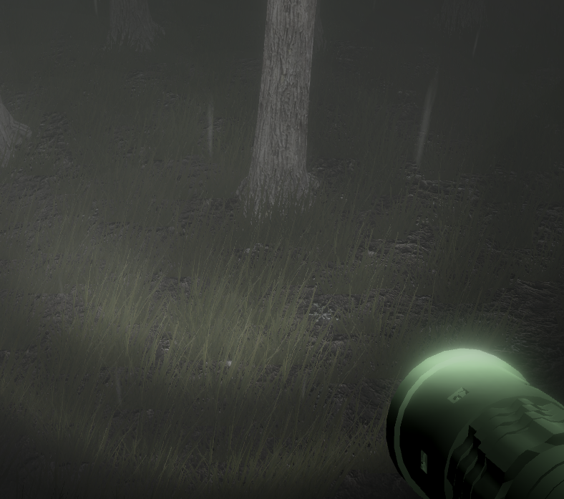

Slide 32
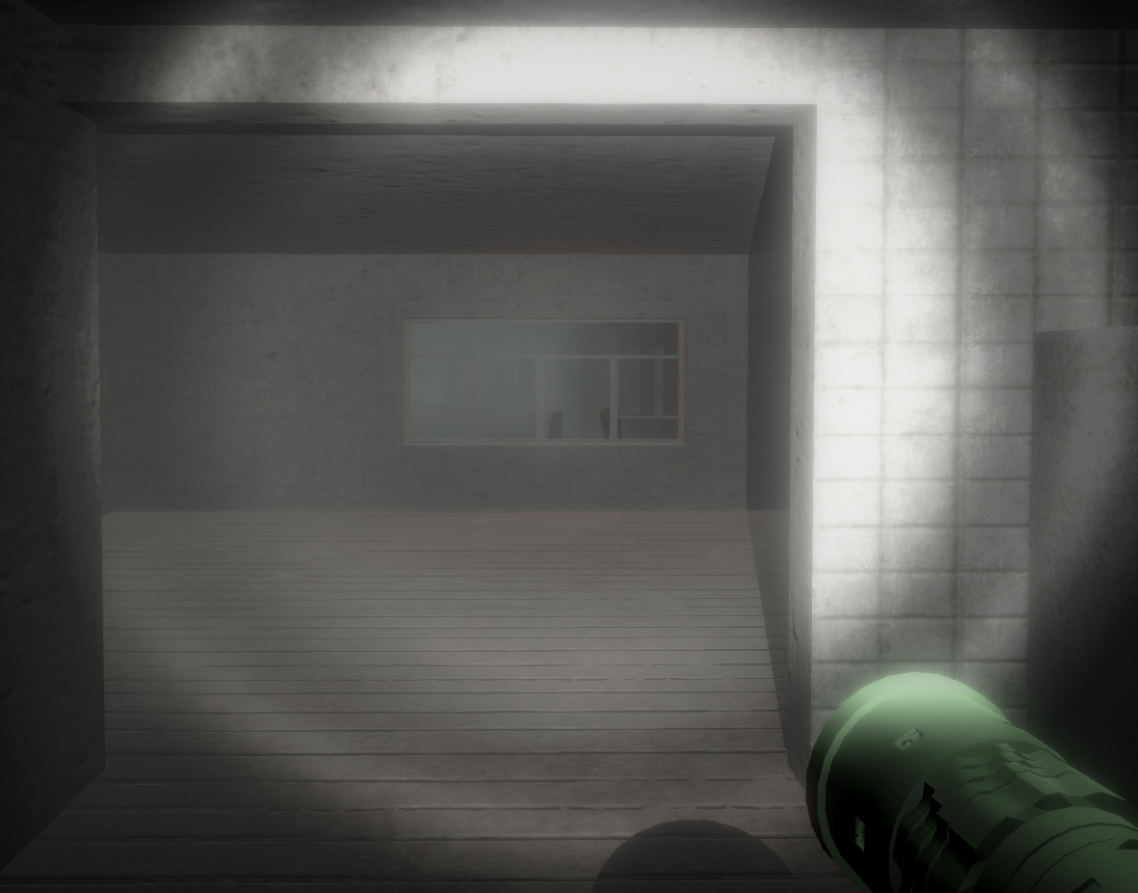
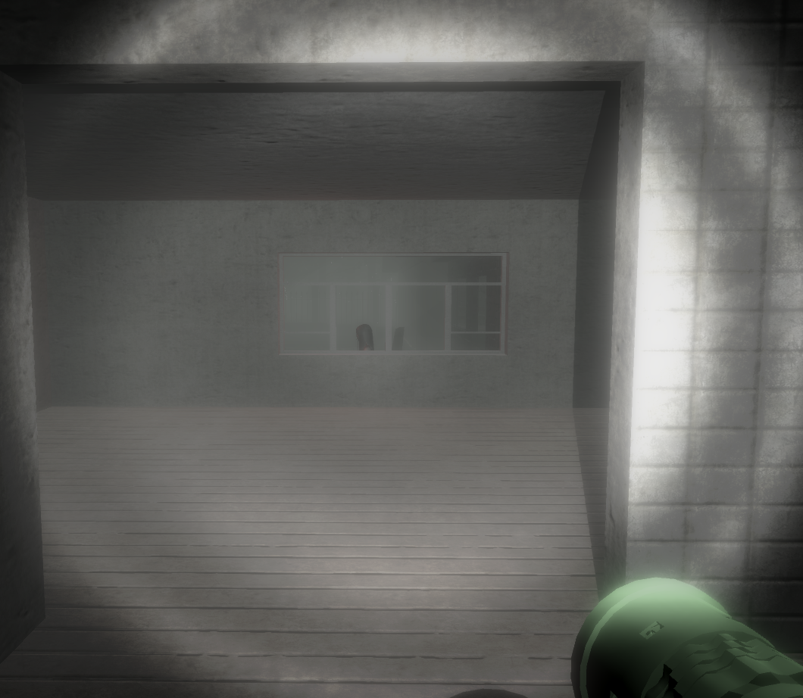

Slide 33
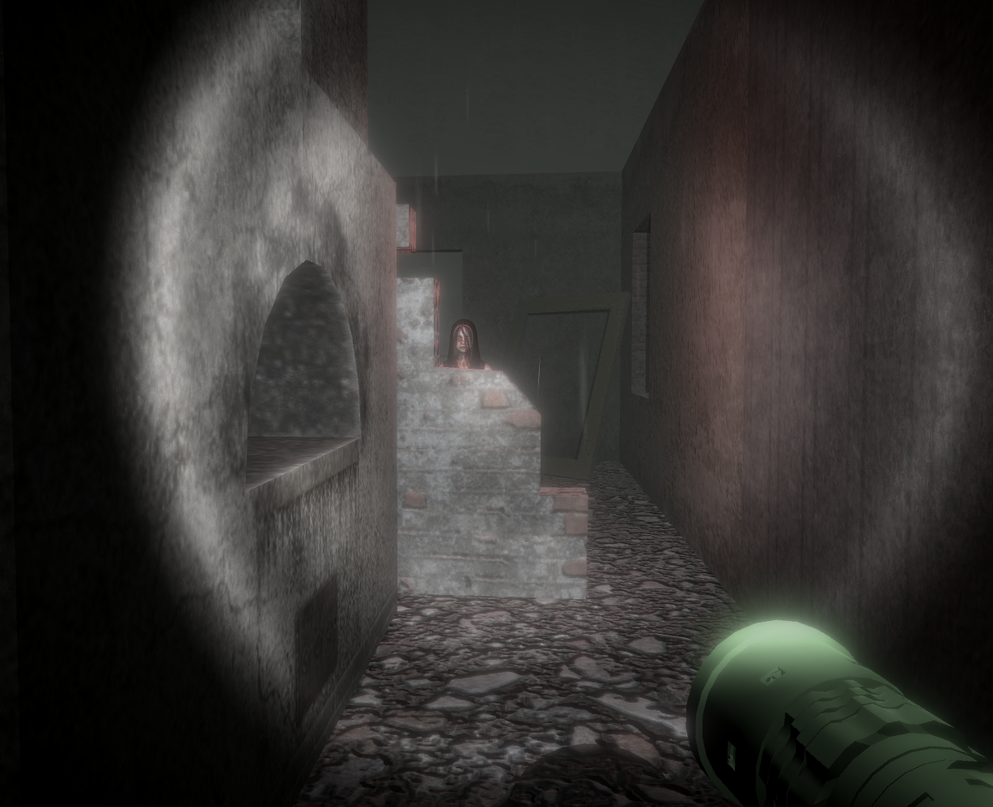

Slide 34
SOUND EFFECTS & MUSIC
There were many sounds used to boost the detail on the scene. For example, the sound of rain drops, the waterfall sound, the thunder, flickering light, the swing are used in the scene. On the second progress, for each pickup (key sound, paper sound), additional songs that a girl sings, scary sound effects when scary moments occur are used in the scene.

Slide 35

LEVEL 2 – BURNT HOUSE (SUMMARY OF #P1)
Proposal images of the level

Slide 36


General vıews of the level

Slide 37


GENERAL VIEWS OF THE LEVEL

Slide 38

LEVEL 2 – BURNT HOUSE (#P2)

Slide 39
MAJOR CHANGES
In the proposal and game progress #1 we defined a house that have only one floor, but we increase the floors of the house for puzzle. Now, house have three floor (ground, first, second). Each floor looks similar to each other.

Slide 40


VIEWS OF THE HOUSE

Slide 41

NEW ASSETS
Doors of the house completely changed. New door assets added to house. Door has scripts and animations for closing/opening animations. Also, doors have creak and slam sound for opening and closing animations.
Door is interactable in the house.

Slide 42

New assets
Exit door added to house. This door is different from other doors of the house. Exit door have animations for opening/closing and scripts. Exit door is locked in the beginning of the scene.
Exit door is interactable in the house.

Slide 43




New aSSETS (puzzle assets)
Switch and key added to house. These are special assets for house’s puzzle.
Switch have animations for opening and closing, sound for switch on/off and script.
Switch is interactable and key is collectible asset in the house.

Slide 44


New Assets
Railing of the stairs are added. This structures are for more realistic view of the scene.

Slide 45

New Assets
Note and pen added to house. These are special assets too.
Note is like manual of the puzzle and interactable asset in the house.

Slide 46



Interfaces (note)
Note interfaces added to house.
When player is near by the note asset a canvas comes up and shows which button is required for interaction.
If player pressed ‘R’ button. A note is opened. This is another canvas and gives hint for solving the puzzle.
Another canvas shows interaction button for closing the note.

Slide 47

Interfaces (swıtch)
Another canvas shown to user for switch on interaction.
When player is near by any switch, this canvas is showing to player until user pressed ‘M’ button.

Slide 48


Interfaces (Tıme/Next Level DIFFICULTY)
Time panel is shown to user in the top left corner of the screen. Time has effect on next level’s difficulty.
At the end of the scene, time panel changes to difficulty panel and shows to user next level’s difficulty.

Slide 49

Interfaces (door)
This canvas is shown to player when player is near by the door except exit door.
Shows interaction button for opening any door in the house.
Stays open until player pressed ‘O’ button or moved away from door.

Slide 50

Interfaces (Exıt Door)
This canvas is shown to player for puzzle’s progress.
If player has not found the key, this canvas comes up when player is near by the exit door.

Slide 51


Interfaces (pıck up/Forbıdden)
Forbidden canvas is shown to player when player near by the stair but difficulty level is low and player can not go upper floor. Stays open until player goes away from stair.
Pick up canvas is shown to player for interaction of the key. If player found the key and near by it, this canvas comes up and stays open until player picked up the key.

Slide 52

Puzzle of the house
At the beginning of the scene player appears in the ground floor of the house.
Manual of the puzzle stays open on the table of the ground floor. That note gives hint for solving the puzzle.

Slide 53

Puzzle of the house
Keys are randomly placed in the house. With respect to difficulty level key may spawn o the upper floors of the house.
Although key is in the room and player entered that room, player can not see the key and can not picked it up.

Slide 54
Puzzle of the House
There is a switch on system in the house.
8 different switches connected to 8 different keys in the scene.
If player wanted to collect the key, player must switch on witch respect to room.

Slide 55

Puzzle of the house
Player has to choose true switch, just one switch stays open in the system. Multiple switches are forbidden.
If the key spawned in the room and player switched on, key is shown to player for collecting.

Slide 56

Puzzle of the House
While player solving the puzzle, he/she encounter environment’s sound changes with respect to floor and the room.
Each room has unique environment sound for jump scares and putting the player in uncomfortable position.

Slide 57

Puzzle of the House
If player collected the key, exit door unlocked and player can go out of the house.
After the player collected the key all environment sounds are stopped and new environment sound is playing.
This sound changes gives hint for story of the house.

Slide 58

End Of the Puzzle
Player must go to exit door for ending the scene.
If player is pressed by ‘O’ button after collected the key and near by the exit door, time is stopped and difficulty level shown to user.
End of the level there is another hint for story.

Slide 59
Sound Effects / Musıc
Sounds are very important for the house. They provide scary and uncomfortable environment.
Door has slam and creak sound for opening/closing.
Switches has switch on sound for opening.
Ground floor have five audio sources, they are girl singing sound, fire sound, wind sound, flickering light sound and water dropping sound.

Slide 60
Sound Effects / Musıc
First floor have five audio sources, they are wind sound, fire sound, girl scream sound, girl crying sound, and someone walking in the room sound effect.
Second floor have five audio sources, they are wind sound, fire sound, knocking door sound, ear ringing sound and dropping sound effects.
After collected the key another girl crying sound is playing for environment.
End of the scene girl talking sound is playing.

Slide 61


LEVEL 3 – HOSPITAL (SUMMARY OF #P1)

Slide 62

LEVEL 3 – HOSPITAL (#P2)

Slide 63

General ARCHITECTURE OF HOSPITAL
LEVEL 3 – HOSPITAL (#P2)
Hospital expanded. Dining room and the surgery room were set up. Now there are 8 patient rooms, 2 bathrooms, 1 kitchen, 1 surgery room and 1 doctor's room in the hospital.

Slide 64


General views of Updated Hospital

Slide 65


General views of Updated Hospital

Slide 66


Kıtchen and surgery room

Slide 67


Updated Doctor's room
New assets added to the room and now doctor is waiting for the patient to come.

Slide 68

Puzzle assets and Mechanısm
Firstly player must find the map to understand the puzzle. Yellow marked areas on the map represent the lights that need to be opened. Other lights must also be turned off as shown in the map to solve the puzzle.

Slide 69

Puzzle assets and Mechanısm
Hospital was surrounded by cables. These cables provide information about each switch connection.

Slide 70


Puzzle assets and Mechanısm
More than one cable can be connected to one switch. Game become more difficult and enjoyable with this feature.

Slide 71

Puzzle assets and Mechanısm
When the puzzle is correctly solved, the doctor's door opens. Doctor is waiting for you.

Slide 72

PROJECT PLAN – GANTT CHART

